Slide 1
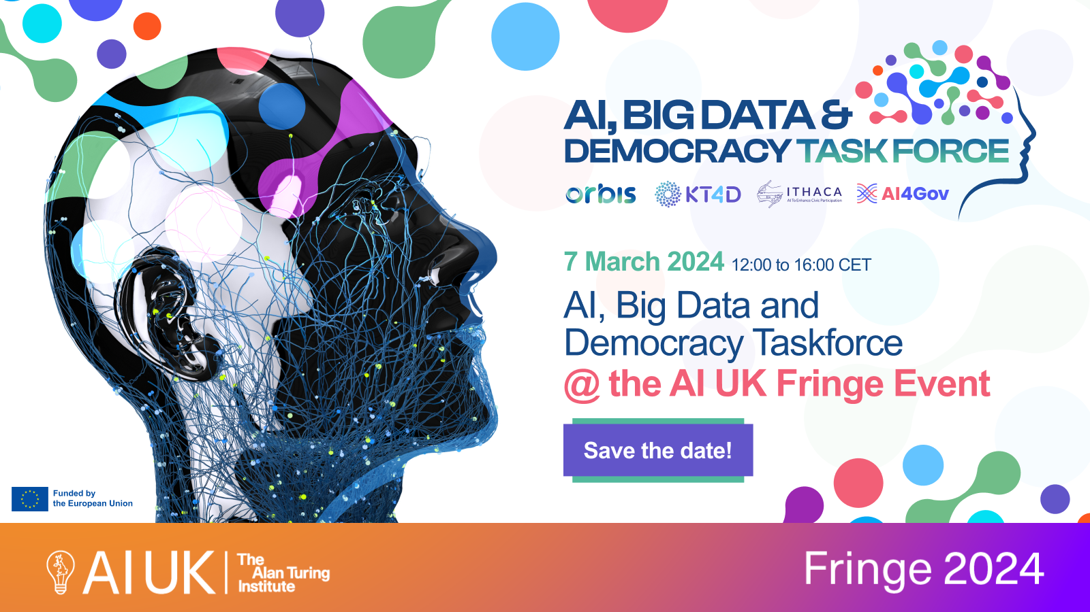
11:00 – 15:00

Slide 2
Join at menti.com | use code 69 06 83 8
Recording notice
Please note, this session will be recorded.
Only speakers will be recorded and any question and answer sessions recorded will be anonymised.
If you have any concerns, please speak to the events team on arrival or contact them via email.

Slide 3
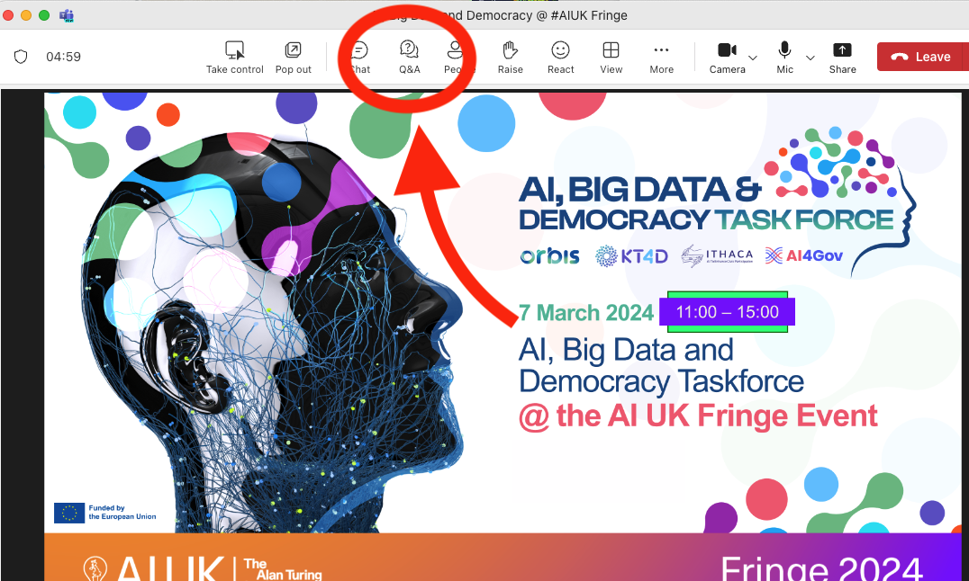
How to participate
QnA
For questions during the presentations to answered at the end by the presenters
Mentimeter survey
For feedback on the presented tools
Join at menti.com | use code 69 06 83 8

Slide 4
Agenda
13:30 - 15:00 | Part 2 Demonstration and hands-on experience of a series of technological tools that address this challenge | BCause: Reasoning for change: A Structured and Decentralised Discussion System for Distributed Decision Making DemocraticReflection: collective intelligence platform to harness real-time audience feedback over live debates DISPUTool: A tool for Mining and Exploring arguments in US Presidential Election Debates, adapted to deliberative democracy debates AI4Gov: A Self-Explained Visualisation Workbench: a Bias Detection Toolkit that empowers policymakers, researchers, and practitioners with understanding tailored for detecting biases in AI systems ORBIS: On the development of a dashboard for deliberation analytics

Slide 5
BCause: Reasoning for change: A Structured and Decentralised Discussion System for Distributed Decision Making
Lucas Anastasiou
The Open University - Knowledge Media Institute
Collective Intelligence and Online Deliberation (Idea group)

Slide 6
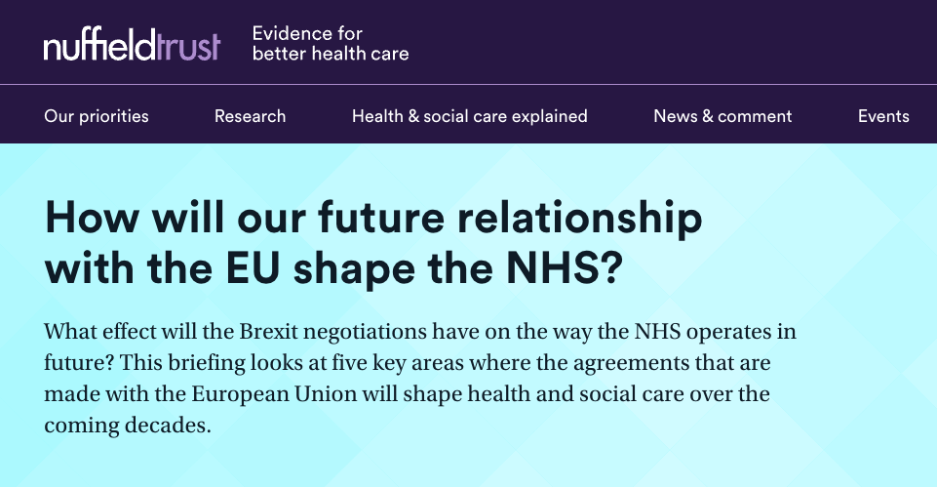
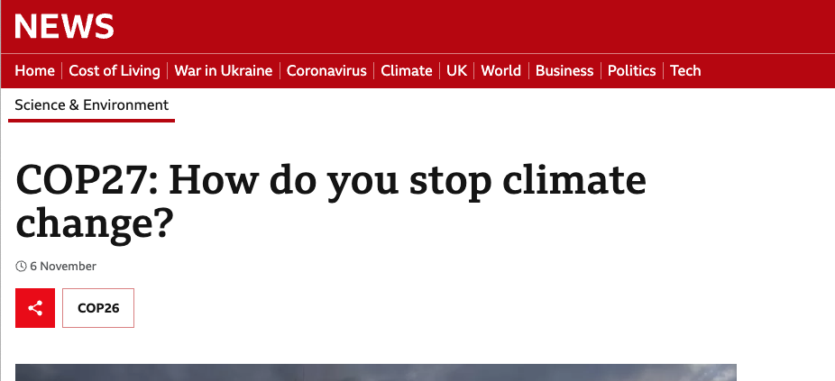
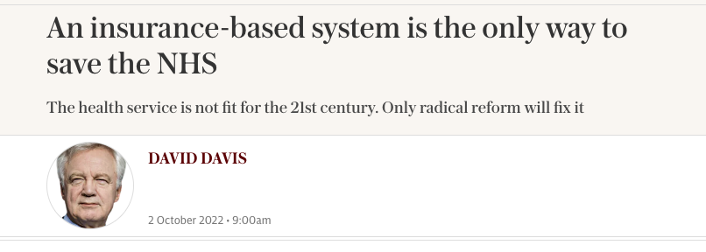
Policy making
Healthcare policy
Plan to address climate change
Strategy to combat crime

Slide 7
Philosophical dilemmas
Notes:
ethics of abortion: Is it morally acceptable to terminate a pregnancy?
The use of artificial intelligence: As AI technology becomes more advanced, there are ethical concerns about the use of AI in decision-making and other areas
The concept of free speech: To what extent should individuals be allowed to express their opinions freely, even if those opinions are controversial or offensive?

Slide 8
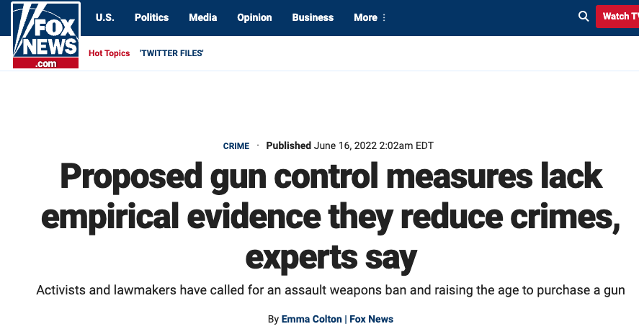
Regulation
Net neutrality
Gun control
Environmental regulations
Immigration regulations
Financial regulations
Notes:
In any case no lack of debates out there!
Net neutrality regulations: the principle that all internet traffic should be treated equally, without discrimination or preference : necessary to ensure a fair and open internet, while others argue that they hinder innovation and investment in the broadband industry.
Gun control regulations: some arguing that stricter regulations are needed to prevent gun violence, while others argue that such regulations violate the right to bear arms
Environmental regulations: protecting the environment, laws governing air and water pollution, the use of hazardous chemicals, protection of endangered species.
Immigration regulations
Financial regulations: The financial industry is heavily regulated, with laws governing the activities of banks, investment firms, and other financial institutions.

Slide 9
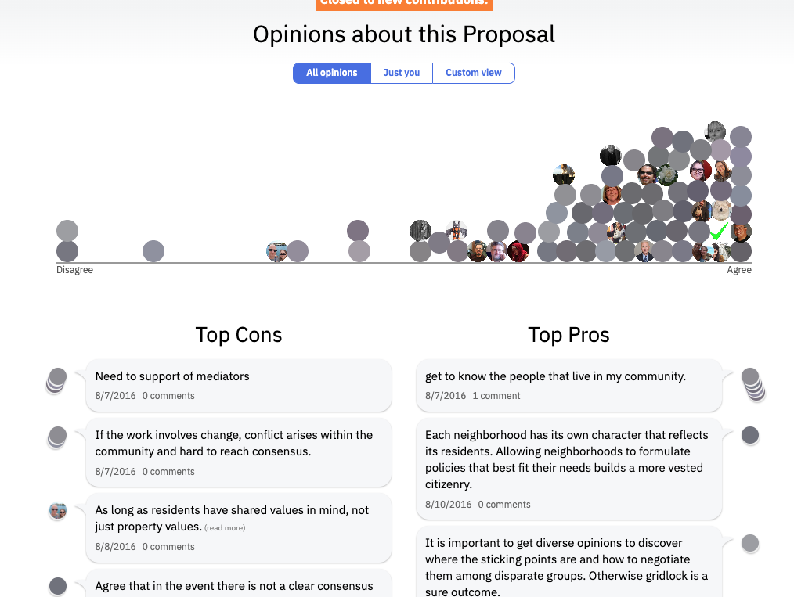
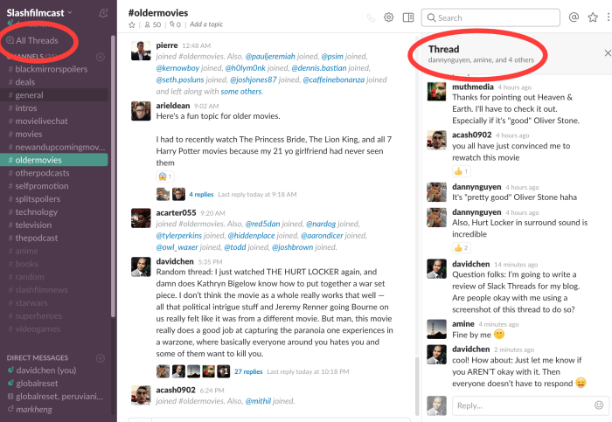
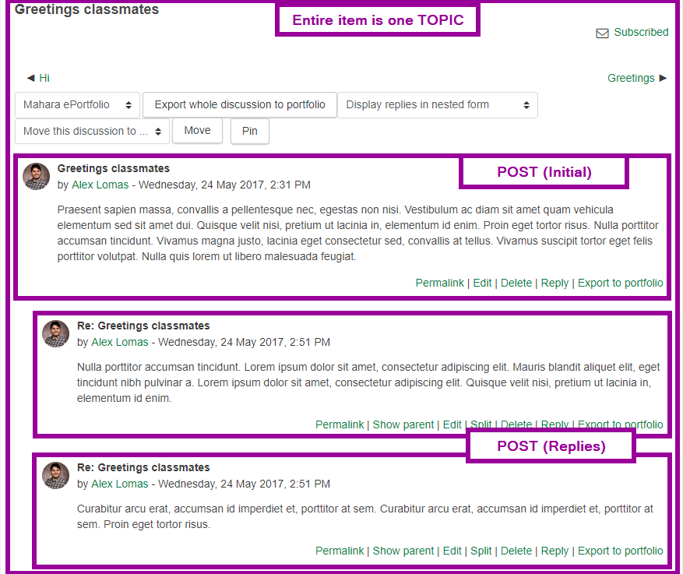
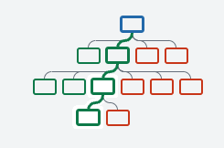
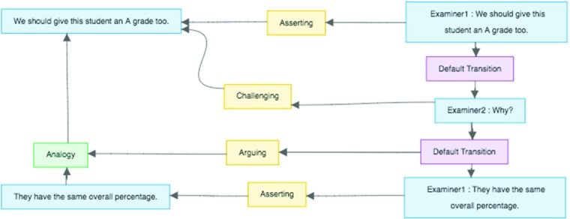
The spectrum of discussion types
Media comment section
Forums with or not reply/ thread/ like
Multi-level argument
Pure linear/ dialogue based
phpBB forum
Reddit
Kialo
Consider.it
Deliberatorium
Slack threads
Pure argumentative
Notes:
Linear vs pure argumentative edge cases: show the spectrum - show in images
Pure linear (dialogue)
Reply
Threads (like slack)
Multi thread - forum
?
Deliberatorium
Kialo - multi level argumentative
AIF
Forum picture from https://sites.google.com/a/ualberta.ca/extension-elearning-resources/eclass-orientation/participating-in-discussion-forums
Reddit picture from https://www.reddit.com/r/webdev/comments/qv5vo5/how_do_design_for_nested_commentsreplies/
time - centric systems:
Low signal to noise ratio
Insular ideation: quickly generated ideas without substance
Balkanization
Non-comprehensive coverage
Dysfunctional argumentation
Opaque processes

Slide 10
What do we use ?
Popularity
Social media
Dedicated argumentative platforms
Forums with reply
Media comment section
Forums with no reply
Forums nested threats
Multi-level argument
Pure linear/ dialogue based
Pure argumentative
Notes:
Normal distribution with a HUGE positive skew to linearity

Slide 11
Can we get best of both worlds?
How can we enable low cost argumentation?
Bcause.app platform incorporates many interventional features from traditional linear discussion platform:
Appreciative elements (like, thank you)
Self reflect
Direct reply
Level of agreement
1-level of argumentation to preserve clarity of inference (meaning) (contrast with Kialo for example)
Automated reporting (summary and identification of points of interest - sensemaking nuggets)
Recommending, Fetching and attaching External scientific evidence
Notes:
Can we retain engagement and maintain high level of argumentation with low cost of entry (low cost argumentation?

Slide 12
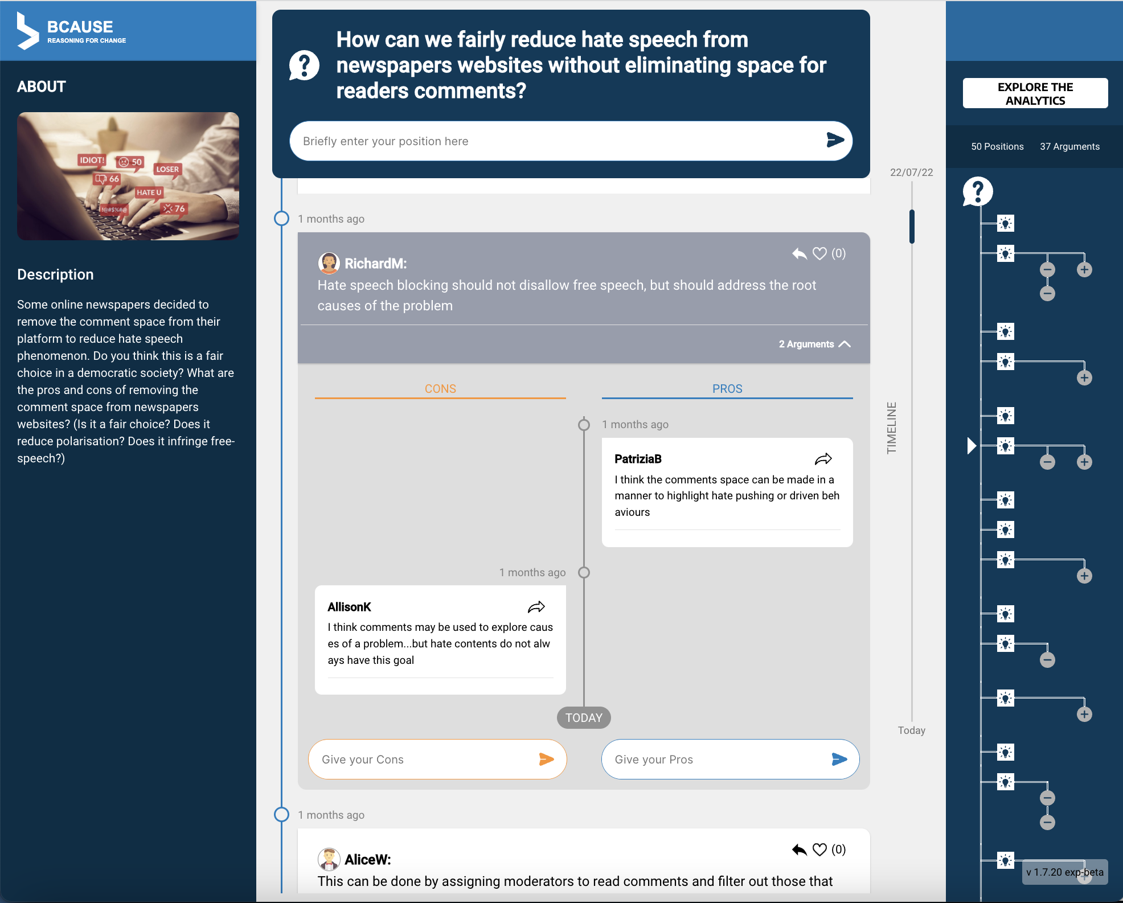
Argumentative discussion
Simple IBIS style discussion: positions with pro (supporting) / con (opposing) arguments
POSITION
PRO ARGS
CON ARGS

Slide 13
Argumentative discussion
Simple IBIS style discussion: positions with pro (supporting) / con (opposing) arguments
Simple Argument Tree visualisation
ARGUMENT
TREE

Slide 14
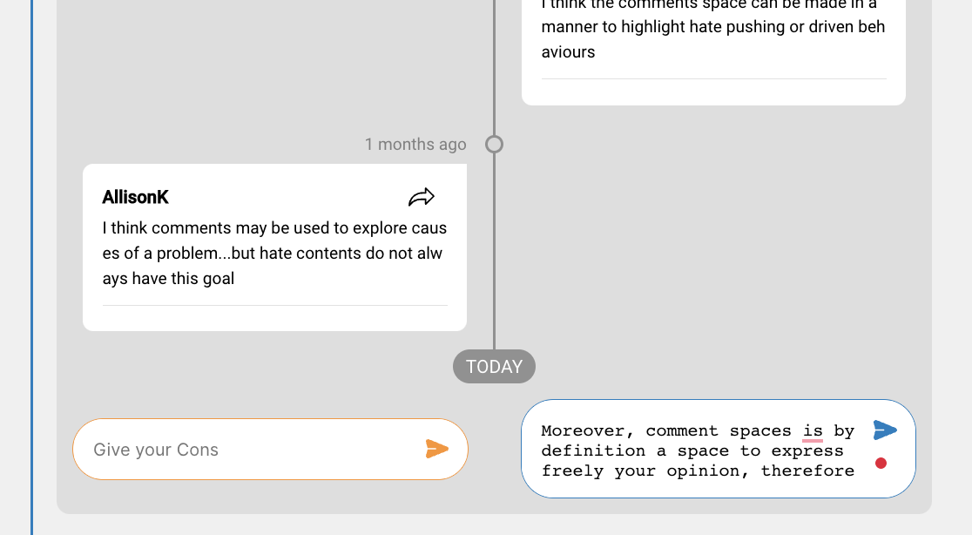
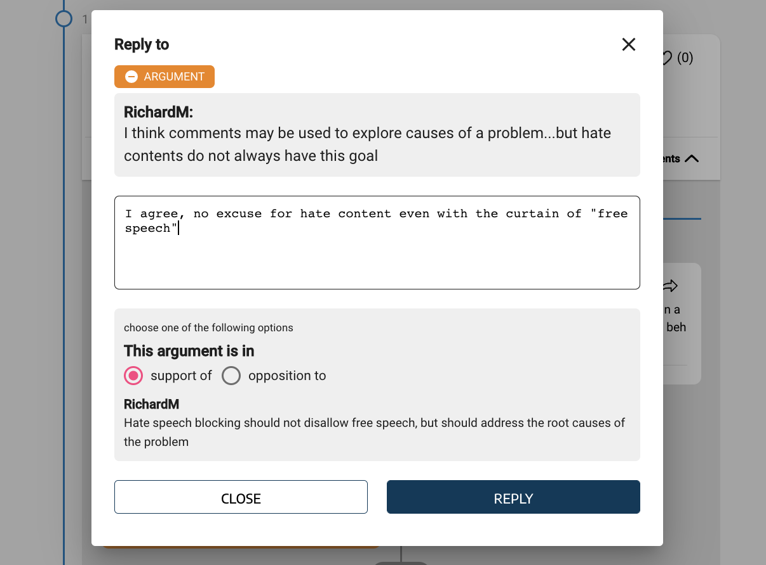
Argumentative discussion
Simple IBIS style discussion: positions with pro (supporting) / con (opposing) arguments
Simple Argument Tree visualisation
Contribute either by:
adding a new position or
Direct reply to a given position
adding argument below given position
Reply to a given argument (select polarity)
Argumentative discussion while retaining timely nature of conversation

Slide 15
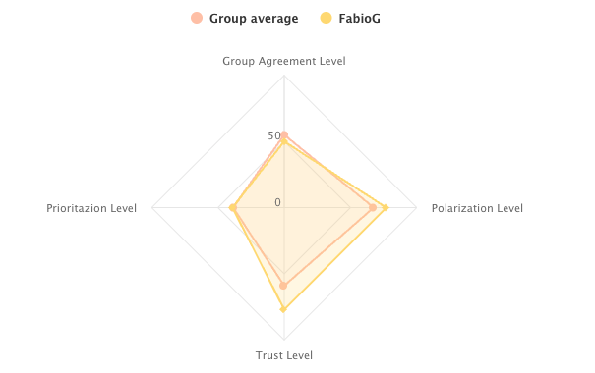
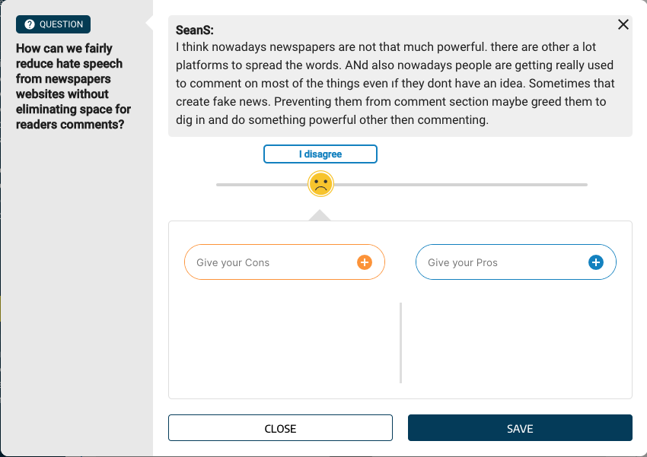
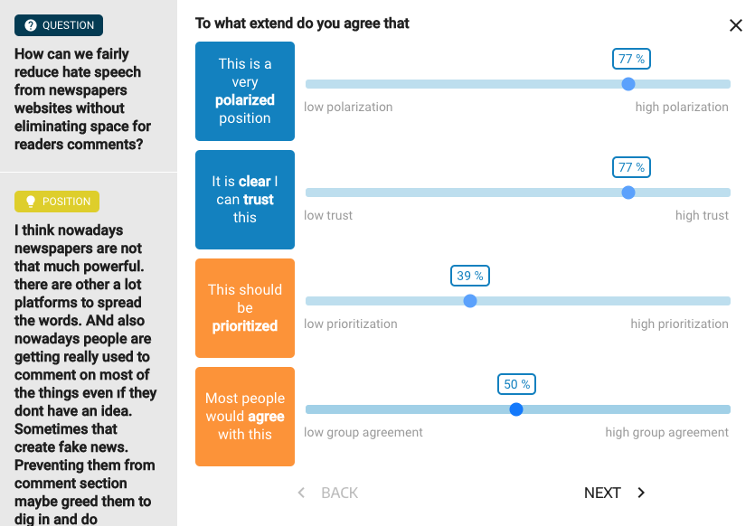
Reflective elements
Agreement and self reflection button

Slide 16
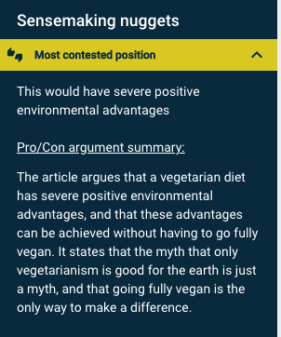
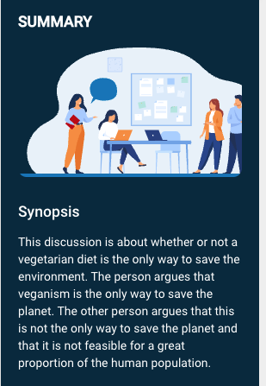
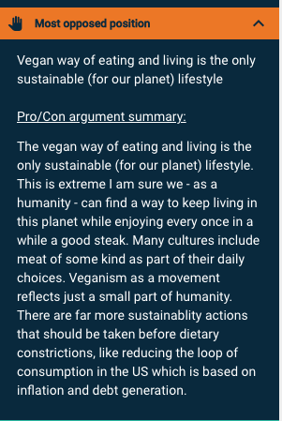
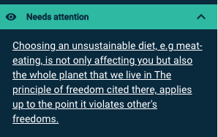
Synoptical summary and Sensemaking nuggets

Slide 17
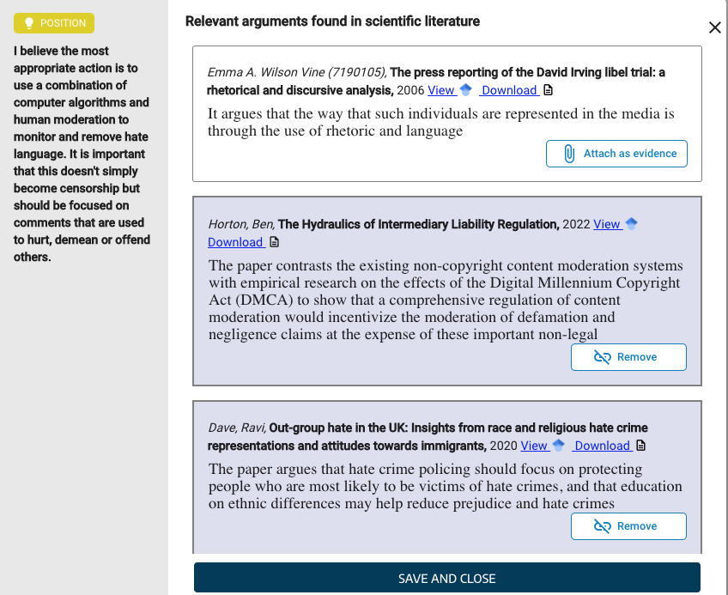
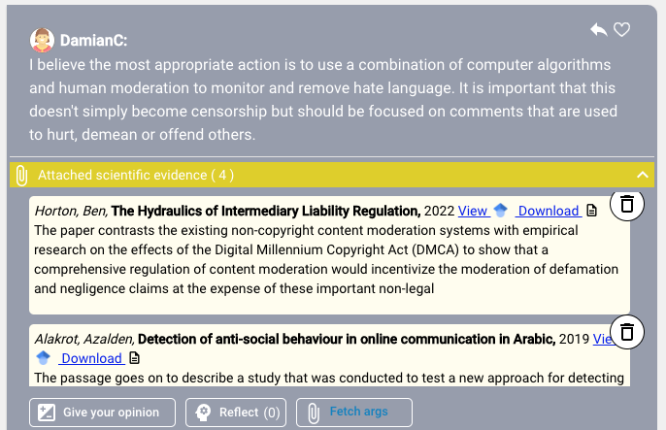
Recommending scientific evidence
Recommending and attaching
External scientific argument evidence

Slide 18
Findings
argumentation structuring does not undermine participation / engagement
(the contrary!)
Has a positive effect on (some factors of) mutual understanding and Sensemaking
Induces more cohere and diverse discussion
Reduces polarisation (less formation of distinct sub-communities within a group)
- along with better quality of interaction among participants
Notes:
3, a possible explanation : a trigger of thoughts, a good prompt/ nudge, provoke some reasoning

Slide 19
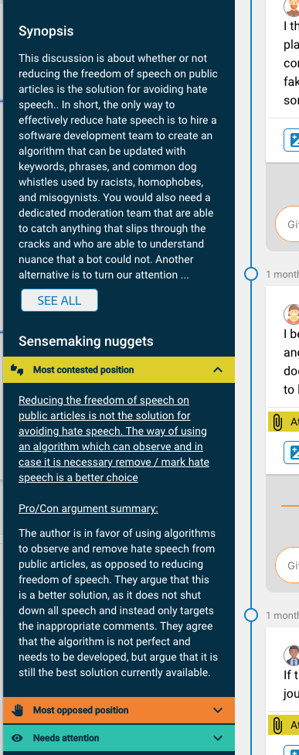
Try it out!
https://bcause.app/
Find out more at:
https://bcause.kmi.open.ac.uk

Slide 20
Agenda
13:30 - 13:00 | Part 2 Demonstration and hands-on experience of a series of technological tools that address this challenge | BCause: Reasoning for change: A Structured and Decentralised Discussion System for Distributed Decision Making DemocraticReflection: collective intelligence platform to harness real-time audience feedback over live debates DISPUTool: A tool for Mining and Exploring arguments in US Presidential Election Debates, adapted to deliberative democracy debates AI4Gov: A Self-Explained Visualisation Workbench: a Bias Detection Toolkit that empowers policymakers, researchers, and practitioners with understanding tailored for detecting biases in AI systems ORBIS: On the development of a dashboard for deliberation analytics

Slide 21
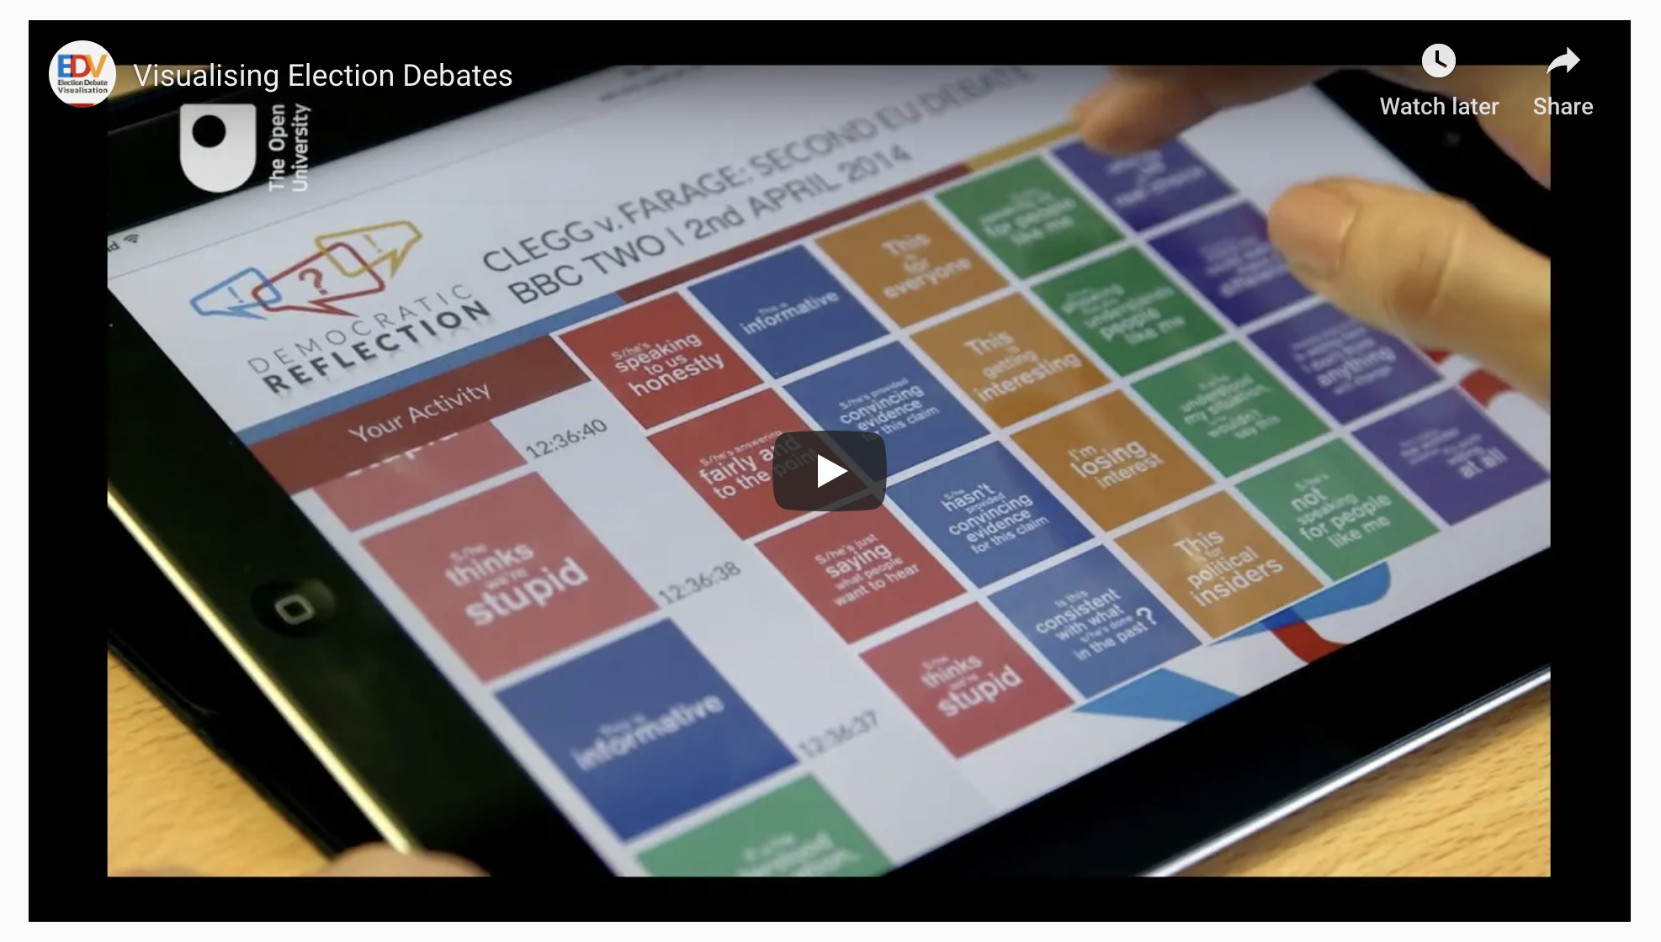
New Modes of Engagement with Live Events or Video Testimonials through Audience Feedback
Minimal Meaningful Instant Feedback Interaction
Concept Video: https://www.youtube.com/watch?time_continue=4&v=xj0gB07yMuU
democraticreflection.cloud
Prof. Anna De Liddo, Knowledge Media Institute,
The Open University, UK
Research Website: idea.kmi.open.ac.uk
Notes:
We’ll use soft feedback analysis to investigate and measure which democratic entitlement is triggered at specific time of the political debate and by specific political topics and actors.

Slide 22
New Modes of Engagement with Televised Political Debate through Audience Feedback
De Liddo, A., Pluss, B., & Ardito, A. (2020). Democratic Reflection: Nudging Citizens? Democratic Engagement with Political Election Debates (pp. 25–29). Presented at the Conference Companion Publication of the 2020 on Computer Supported Cooperative Work and Social Computing, New York, NY, USA: Association for Computing Machinery. http://doi.org/10.1145/3406865.3418562

Slide 23
Setting the Problem
The way people engage with televised political debates today is progressively shifting form “passive” viewing of a television programme, to “active” participation to a multiple media event, also involving second screen interaction via social media

Slide 24
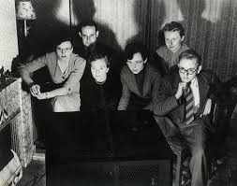
The past….

Slide 25
The present…
The past….

Slide 26
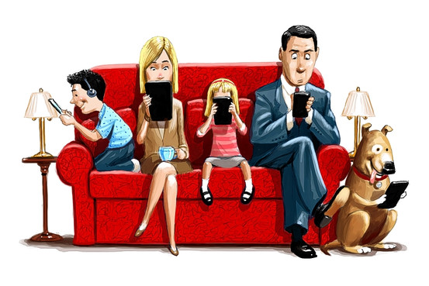
The present…
The past….
?The Future?

Slide 27
Research Questions:
Is the current “participation experience” with political debates really informative? And to what extent does it improves citizens’ confidence about the issues discussed?
Do social media voices truly capture the richness of citizens’ reactions to political debates?
What could we learn about the audience of political election debate, and about the debate as media event, if we had better analytical tools to scrutinize audience’s understanding and reactions?

Slide 28
Concept and Technology
Democratic Reflections, is an innovative audience feedback tool that allows people watching a testimonial video, to instantly express their inner cognitive and emotional reactions to the viewing experience.
From this personal interaction, the tool creates a blueprint of both the personal and collective experience viewers are going through, which is then used to generate a series of analytics and visualisations to enhance personal learning and reflection.

Slide 29
Democratic Reflection’s Interactive Experience
Notes:
The User Experience of Democratic Reflection can be described as follows. Before the event or video replay, people are asked to fill in a pre-survey in which audience demographics are recorded, and participants are introduced to the novel tool and viewing experience. After that users are asked to watch the video, or the live event, while at the same time clicking on reflective statements (appearing on the screen of a computer, tablet or phone as digital cards). Those sentences serve as nudges to look at the content under a specific reflection lens. After interaction, users can access their personalised analytics, and are asked to provide post-hock feedback on their experience.

Slide 30
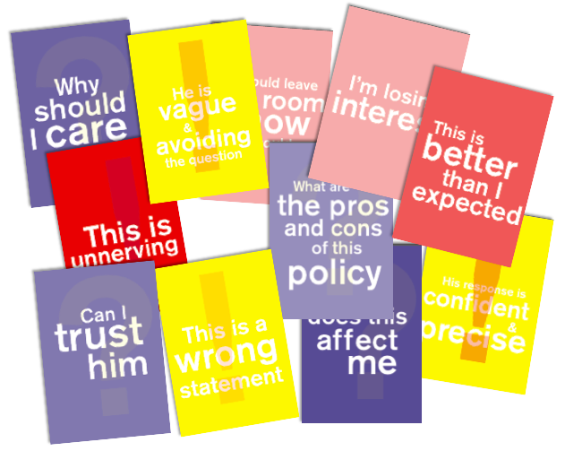
A New Method to Harness Audience Reactions
Minimal Meaningful Instant Feedback as Reflective Statements
‘Soft’ Feedback:
Instant
Nuanced meaning
Discourse-based: Provided in form of discourse elements
Voluntary and non-intrusive
Enabling analytics and visualisations
Notes:
A variety of reflective nudges can be designed to capture dimensions such as democratic engagement, emotional reactions, citizen trust and information needs (see Figure 1 for example nudges/reflective statements from the 2019 elections testing). The Democratic Reflection nudges capture very nuanced but high semantically charged reactions that would be very hard to capture with other polling or opinion elicitation methods.
The quality of the insights that can be derived by this method is in the careful design of the reflective nudges, and is magnified by the time indexing (reactions are captured in the moment). This allows a precise identification of the context and target of the audience reaction (what was being said, and by who, when the audience clicked that digital card). The design of the cards’ statements is a key pre-engagement activity, that needs to be carried out by the engagement team and usually involves focus group discussions with a small panel of participants.

Slide 31
Audience Feedback Objectives
promoting active engagement by enabling the audience to react to the televised debates in new unobtrusive, yet expressive, and timely manner;
harnessing and analysing viewers’ reactions to better understand the audience and their debate experience;
Enabling self and collective reflection, sensemaking and learning through personalized advance analytics and visualisations
providing new metrics to assess the debate as media event in terms of its capability to engage the audience emotionally, intellectually, critically and democratically.

Slide 32
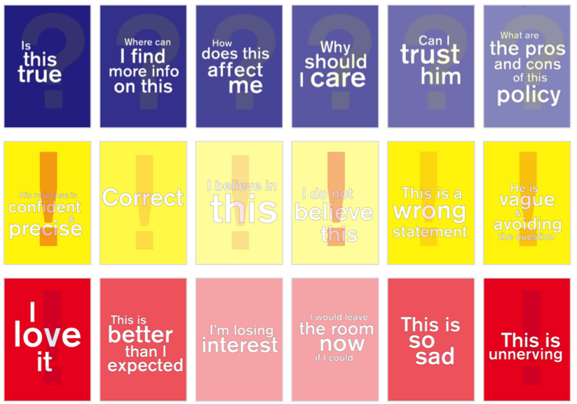
A paper prototype: the flashcard experiment
18 flascards in 3 categories
Emotion
Trust
Information need
15 participants watched the second Clegg-Farage debate live
Video annotations in Compendium (and Youtube!)
Notes:
To test the soft feedback idea we designed an experiment in which audience reactions were captured by using flashcards. Flashcards consist of paper cards containing textual information and are often used in learning contexts for memory training. We used them to help viewers to reflect on the specific “concepts” captured by the flashcard text. The flashcards’ spaced order and repetition was used as a method to help participants memorising the cards. Card’s colour, and typographic style was also carefully designed to help participants to easily focus on the key concept captured by the card.
The aim of the cards was to elicit three main types of reactions to the speakers’ utterances: emotional, trust, and information needs reactions.
The trust cards (yellow cards) were designed to provide insights on the main motivations for audience’s trust/distrust. They were specifically designed with the gaol in mind to
distinguish between trust on the speaker, the debate content, and pre-existing beliefs.
The emotion cards (red cards) were designed to provide insights on audience’s emotional reactions to the debate and can be used as proxy to assess people engagement with the speakers and the debated topics.
Finally the questions cards (blue cards) were designed to provide insights on audience’s information needs. This deck of cards also aimed to inform the type of information analysis and visualizations to be implemented in the EDV replay platform, in order to make the audience viewing experience more informative.
In the following we list the trust cards we designed and the associated type of trust each card aimed at capturing. The cards colours, and typographic style was carefully designed to help participants to easily focus and memorise the key concept captured by each card.

Slide 33
Trust Cards
designed to provide insights on the main motivations for audience’s trust/distrust.
…. to distinguish between trust on the speaker, the debate content, and pre-existing beliefs.
Notes:
To test the soft feedback idea we designed an experiment in which audience reactions were captured by using flashcards. Flashcards consist of paper cards containing textual information and are often used in learning contexts for memory training. We used them to help viewers to reflect on the specific “concepts” captured by the flashcard text. The flashcards’ spaced order and repetition was used as a method to help participants memorising the cards. Card’s colour, and typographic style was also carefully designed to help participants to easily focus on the key concept captured by the card.
The aim of the cards was to elicit three main types of reactions to the speakers’ utterances: emotional, trust, and information needs reactions.
The trust cards (yellow cards) were designed to provide insights on the main motivations for audience’s trust/distrust. They were specifically designed with the gaol in mind to
distinguish between trust on the speaker, the debate content, and pre-existing beliefs.
The emotion cards (red cards) were designed to provide insights on audience’s emotional reactions to the debate and can be used as proxy to assess people engagement with the speakers and the debated topics.
Finally the questions cards (blue cards) were designed to provide insights on audience’s information needs. This deck of cards also aimed to inform the type of information analysis and visualizations to be implemented in the EDV replay platform, in order to make the audience viewing experience more informative.
In the following we list the trust cards we designed and the associated type of trust each card aimed at capturing. The cards colours, and typographic style was carefully designed to help participants to easily focus and memorise the key concept captured by each card.

Slide 34
Emotion Cards
Designed to provide insights on audience’s emotional reactions to the debate and can be used as proxy to assess people engagement with the speakers and the debated topics.
Notes:
To test the soft feedback idea we designed an experiment in which audience reactions were captured by using flashcards. Flashcards consist of paper cards containing textual information and are often used in learning contexts for memory training. We used them to help viewers to reflect on the specific “concepts” captured by the flashcard text. The flashcards’ spaced order and repetition was used as a method to help participants memorising the cards. Card’s colour, and typographic style was also carefully designed to help participants to easily focus on the key concept captured by the card.
The aim of the cards was to elicit three main types of reactions to the speakers’ utterances: emotional, trust, and information needs reactions.
The trust cards (yellow cards) were designed to provide insights on the main motivations for audience’s trust/distrust. They were specifically designed with the gaol in mind to
distinguish between trust on the speaker, the debate content, and pre-existing beliefs.
Finally the questions cards (blue cards) were designed to provide insights on audience’s information needs. This deck of cards also aimed to inform the type of information analysis and visualizations to be implemented in the EDV replay platform, in order to make the audience viewing experience more informative.
In the following we list the trust cards we designed and the associated type of trust each card aimed at capturing. The cards colours, and typographic style was carefully designed to help participants to easily focus and memorise the key concept captured by each card.

Slide 35
Questions Cards
Designed to provide insights on audience’s information needs.
.. in order to make the audience viewing experience more informative.
Notes:
To test the soft feedback idea we designed an experiment in which audience reactions were captured by using flashcards. Flashcards consist of paper cards containing textual information and are often used in learning contexts for memory training. We used them to help viewers to reflect on the specific “concepts” captured by the flashcard text. The flashcards’ spaced order and repetition was used as a method to help participants memorising the cards. Card’s colour, and typographic style was also carefully designed to help participants to easily focus on the key concept captured by the card.
The aim of the cards was to elicit three main types of reactions to the speakers’ utterances: emotional, trust, and information needs reactions.
The trust cards (yellow cards) were designed to provide insights on the main motivations for audience’s trust/distrust. They were specifically designed with the gaol in mind to
distinguish between trust on the speaker, the debate content, and pre-existing beliefs.
The emotion cards (red cards) were designed to provide insights on audience’s emotional reactions to the debate and can be used as proxy to assess people engagement with the speakers and the debated topics.
Finally the questions cards (blue cards) were designed to provide insights on audience’s information needs. This deck of cards also aimed to inform the type of information analysis and visualizations to be implemented in the EDV replay platform, in order to make the audience viewing experience more informative.
In the following we list the trust cards we designed and the associated type of trust each card aimed at capturing. The cards colours, and typographic style was carefully designed to help participants to easily focus and memorise the key concept captured by each card.

Slide 36
A paper prototype: the flashcard experiment
Notes:
We used as test-bed the second political debate between Nick Clegg and Nigel Farage about whether the UK should be in or out of the EU (one hour debate hosted by BBC television on April 2th 2014 http://www.bbc.co.uk/news/uk-politics-26443312).
A study was run with 15 Leed’s University students in which participants were asked to watch the political debate and raise the flashcards as the debate unfolded. Students were asked to raise the flashcard that most represented their “feeling” toward what was being said by the politicians during the debate. This procedure was repeated throughout the entire debate allowing the participants to raise the cards as many times as they wanted, whenever any event during the debate triggered any reaction from their

Slide 37
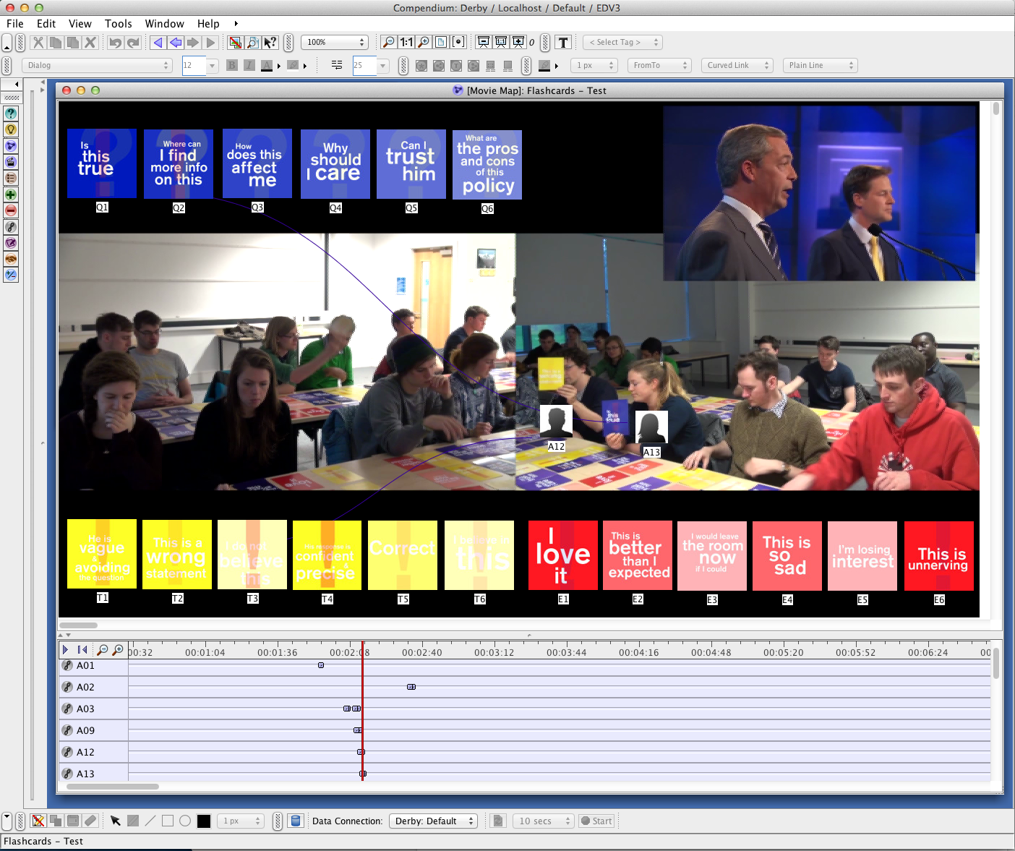
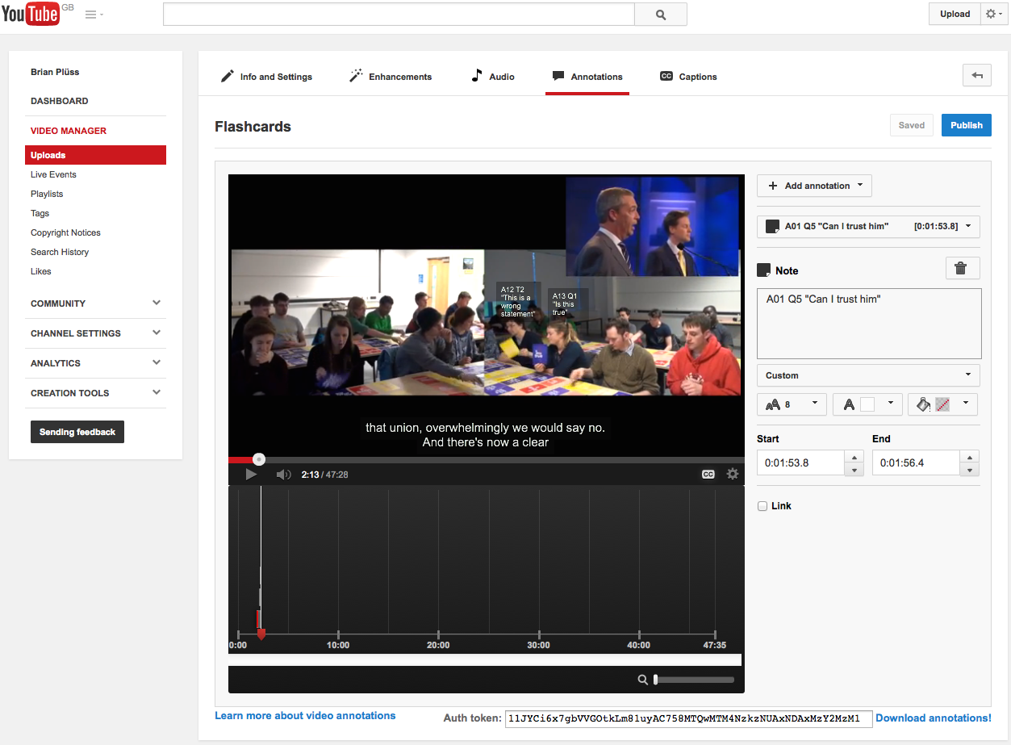
Coding and Annotation of the Video
Quantitative analysis
Frequently used/unused cards
Most used categories
Do the dimensions make sense?

Slide 38
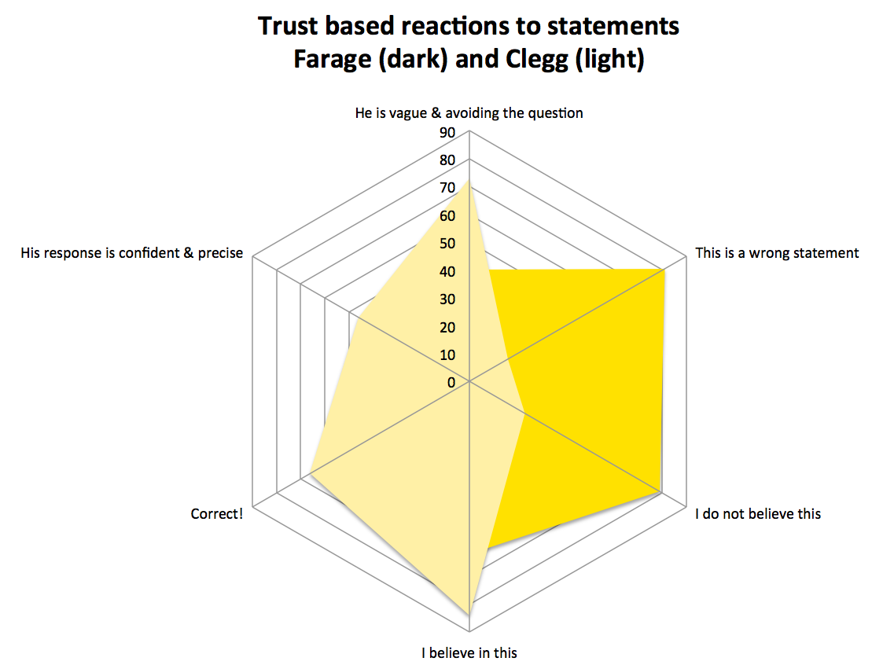

Slide 39
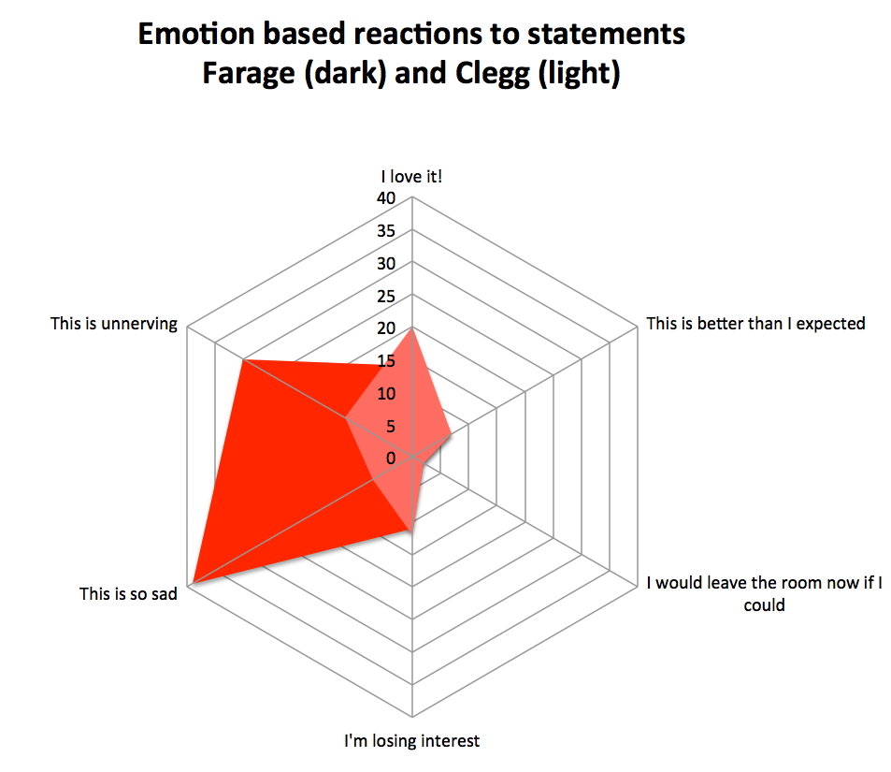

Slide 40
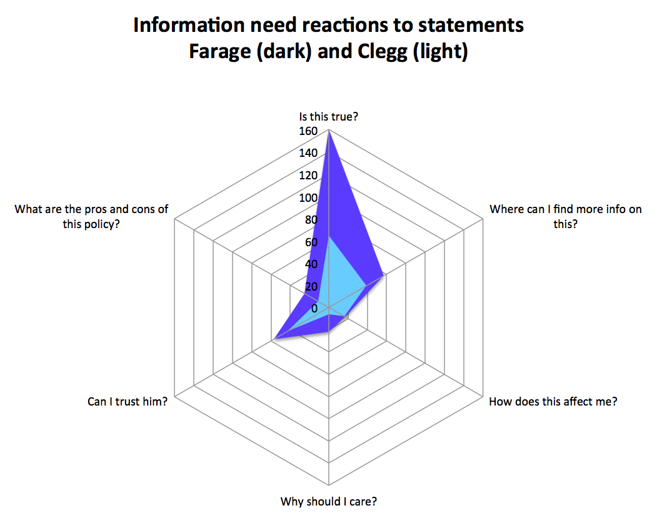

Slide 41
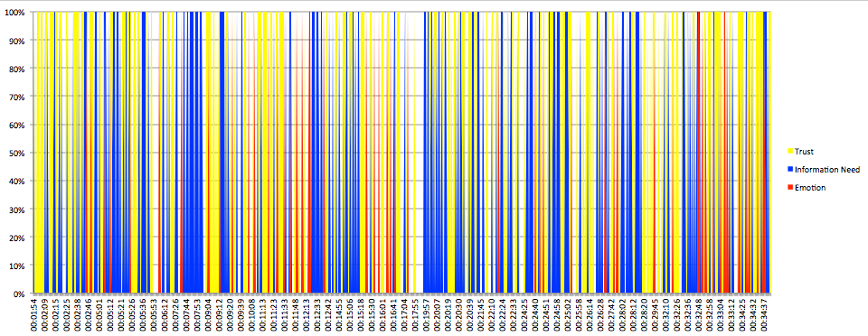
Is this TRUE?
Where can I find more info on this?
Farage: “…actually sixty-two percent of the people that were surveyed in that British car manufacture interview they want serious reform within the European Union if they're gonna stay as members. So, far from the top line being true, two-thirds of them are saying unless we get reform then the time has come to leave the EU.”
Farage: “You can't do that. You haven't got this power. You haven't got this control.” Clegg: “Yes, you do. Yes, you do.”
Farage: “We do not have that power as members of the European Union and that's the truth of it.” Clegg: “Yes, you do. Yes.”
Who to TRUST?

Slide 42
Audience Feedback Web App
DEMO
Please go to democraticreflection.cloud
For citizens/users at large
For analysts (political analysts, digital journalists)
For domain experts (Politicians, Media Broadcasters)
Notes:
We’ll use soft feedback analysis to investigate and measure which democratic entitlement is triggered at specific time of the political debate and by specific political topics and actors.

Slide 43
2015 Election Debate
Panel of 400 people
Experiment in the wild (2500 people linked in the first 5 minutes)
Notes:
We’ll use soft feedback analysis to investigate and measure which democratic entitlement is triggered at specific time of the political debate and by specific political topics and actors.

Slide 46
2017 Election Debate & 2018 Brexit Debate
Mobile Application
First analytics interface
New feedback intensity interaction
2 panels of 20 people
Experiment in the wild
546 people panel
Notes:
We’ll use soft feedback analysis to investigate and measure which democratic entitlement is triggered at specific time of the political debate and by specific political topics and actors.

Slide 48
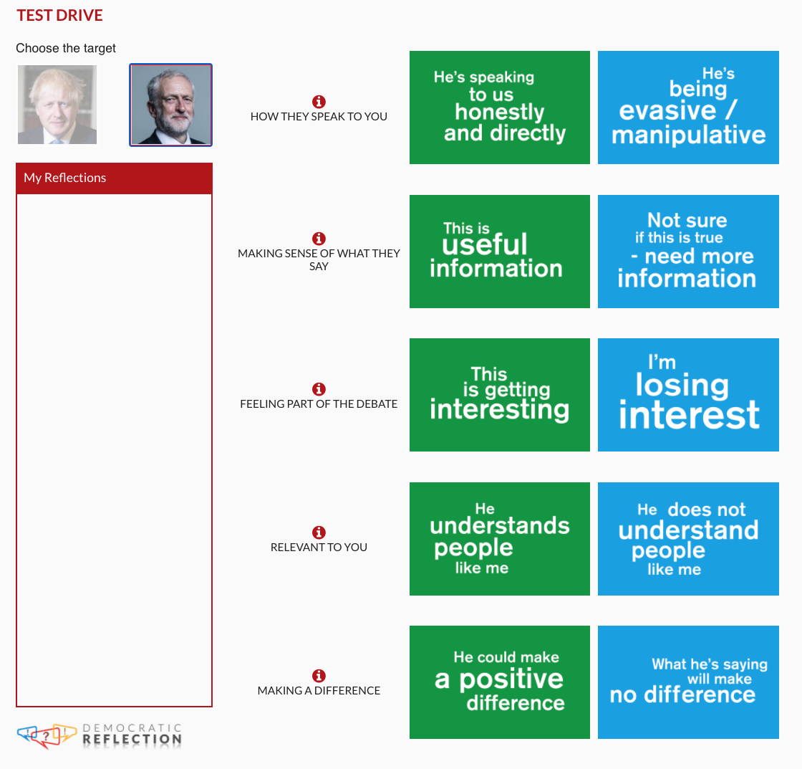
Nov 19, 2019 - Johnson VS Corbyn
Notes:
We’ll use soft feedback analysis to investigate and measure which democratic entitlement is triggered at specific time of the political debate and by specific political topics and actors.

Slide 49
Visual Analytics
Personal/Self reflection Analytics
Collective Analytics
to be viewed:
Post hoc
both static and dynamic visualisations
Notes:
We’ll use soft feedback analysis to investigate and measure which democratic entitlement is triggered at specific time of the political debate and by specific political topics and actors.

Slide 51
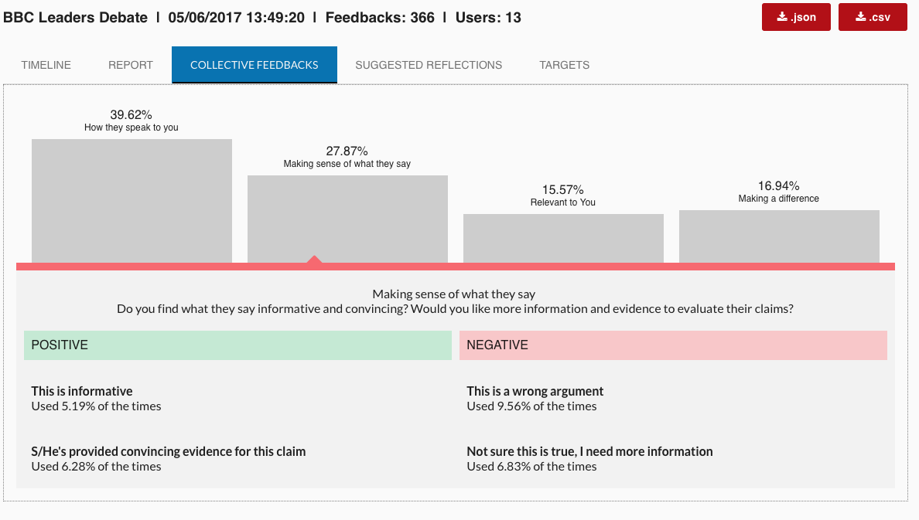

Slide 52
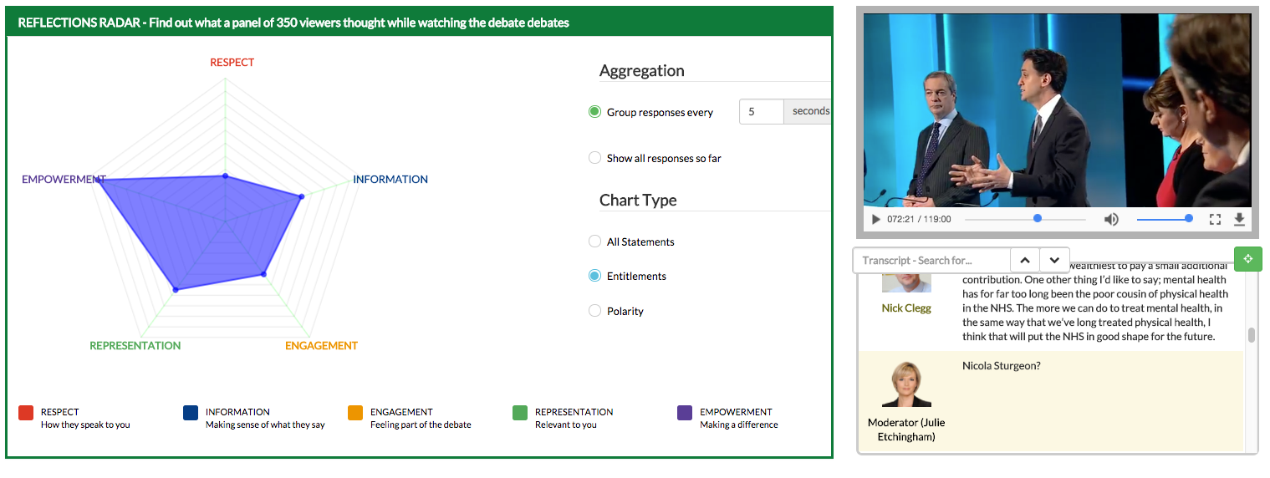

Slide 53
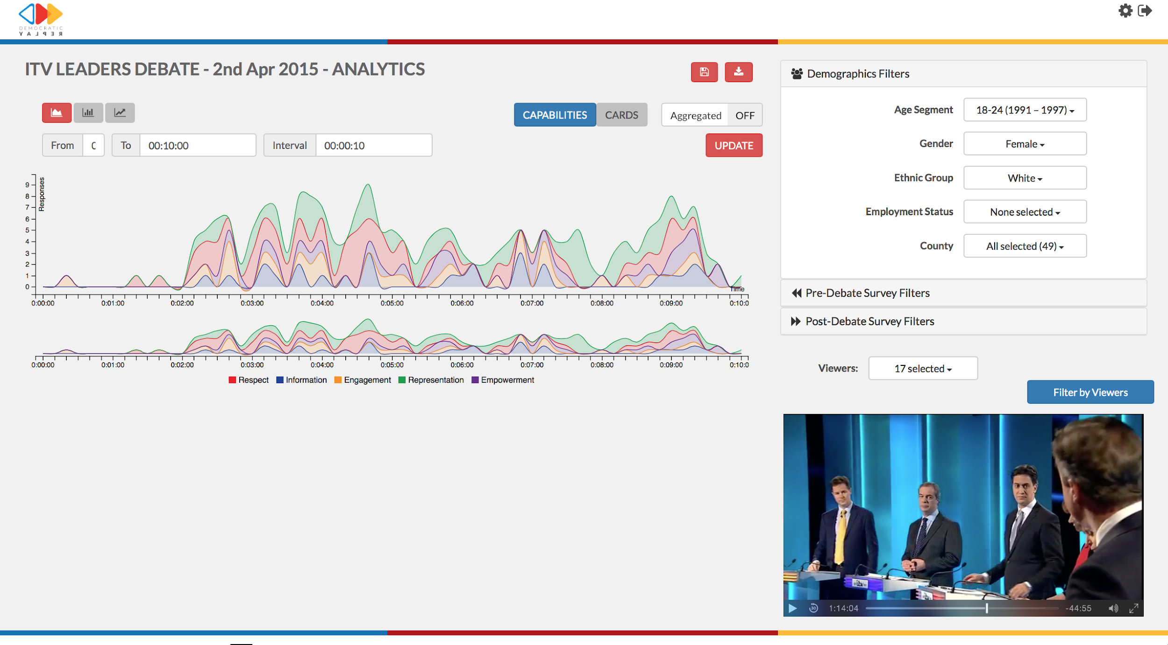

Slide 54
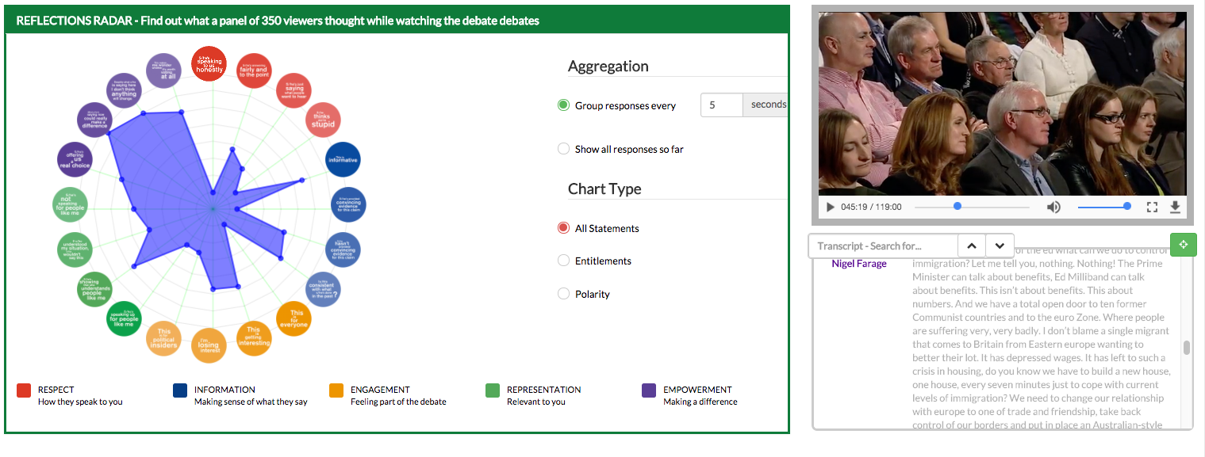

Slide 55
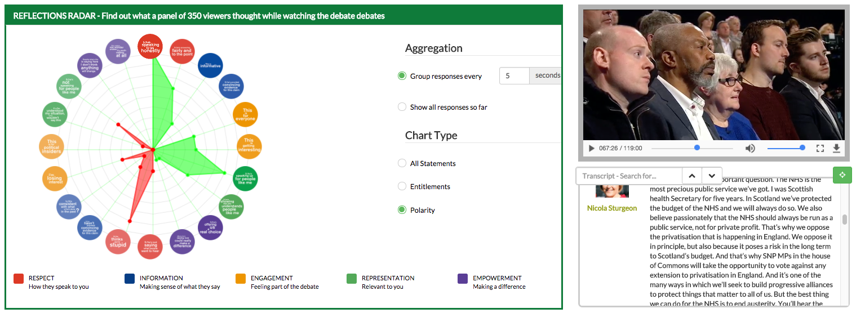

Slide 56
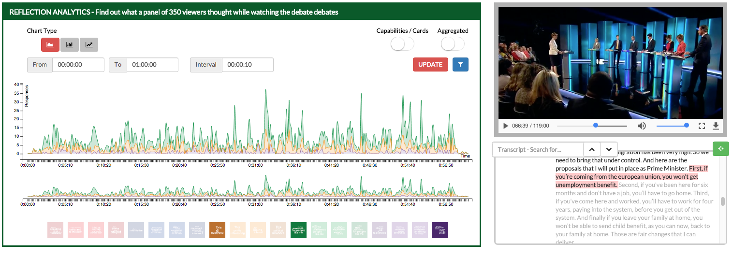

Slide 58
Lessons Learned

Slide 59
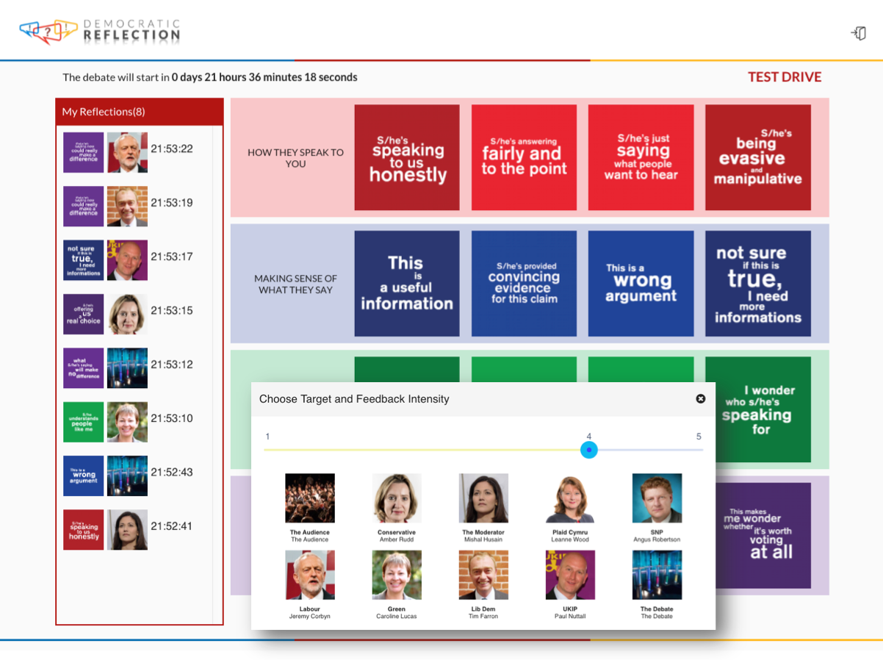
Previous successful testing in Political Communication Contexts
Democratic Reflection was tested with over 2000 UK citizen in the last 2015, 2017 and 2019 political election debates, and was reported to improve self-reflection and learning, “change the way people felt about political leaders”, and showed to “change personal assumptions” that people had before using the tool.

Slide 60
Emerging insights from the last 2015, 2017, 2019 UK General Elections
Democratic Reflection facilitated:
High engagement and willingness to use the tool in the future
No usability issues (also from people with very low digital literacy)
Improved sensemaking
“unexpected insights on the debaters and on what they said,”
To “reflect on the debate in a deeper way”
“assessing personal assumption” and
“changing some initial assumptions had before the debate.”

Slide 61
Emerging insights from the real-life testing of Democratic Reflection
Effective nudging method to promote citizen engagement in politics
Wide majority of participants claimed “changed the way in which they would like to be involved in political election debates in the future” and “using the digital cards made them want to interact more often with televised political programmes”
Quantitative accounts of how participants used the tool have also confirmed previous CSCW research, suggesting an inconsistency between post-hoc and real-time reporting.

Slide 62
Future Research Challenges

Slide 63
Open Research Questions
Are moment-by-moment reactions more authentic than post-hock reflections?
Which one of the two reactions modalities can better predict users’ future actions?
And how can we combine them to improve the audience’s understanding and experience?
These questions can inform future research on hybrid interaction systems, that may provide richer accounts of users understanding and reactions, by combining in the moment and post-hoc interactions.

Slide 64
Future Developments
Create a platform which is fully customisable in terms of events, interface and interaction features
offers different level of engagement and services
Provide specific analytics and visualisations to improve both users’ and analysts’ experience.
Notes:
We’ll use soft feedback analysis to investigate and measure which democratic entitlement is triggered at specific time of the political debate and by specific political topics and actors.

Slide 65
Thank you for listening!
Please fell free to contact me at anna.deliddo@open.ac.uk
to know more about our work please visit the research group website at:
idea.kmi.open.ac.uk
Notes:
We’ll use soft feedback analysis to investigate and measure which democratic entitlement is triggered at specific time of the political debate and by specific political topics and actors.

Slide 66
Agenda
13:30 - 13:00 | Part 2 Demonstration and hands-on experience of a series of technological tools that address this challenge | BCause: Reasoning for change: A Structured and Decentralised Discussion System for Distributed Decision Making DemocraticReflection: collective intelligence platform to harness real-time audience feedback over live debates DISPUTool: A tool for Mining and Exploring arguments in US Presidential Election Debates, adapted to deliberative democracy debates AI4Gov: A Self-Explained Visualisation Workbench: a Bias Detection Toolkit that empowers policymakers, researchers, and practitioners with understanding tailored for detecting biases in AI systems ORBIS: On the development of a dashboard for deliberation analytics

Slide 67
DISPUTool
A tool for Mining and Exploring Argumentative Debates

Slide 68
Overview
The importance of AI as a tool for democracy.
Argument Mining to understand debate process.
DISPUTool as a use case example of AI helping democracy.
Adapting DISPUTool for deliberative democracy.

Slide 69
AI as a tool for Democracy
AI can be either beneficial or detrimental for democracy.
The case of Cambridge Analytica is an excellent example of the dangers of AI if applied wrongly.
The surge of Large Language Models sets up the challenge of disinformation.
Fake news, political advertising, the replacement of traditional web search for chatbots, etc.
We must provide AI solutions to fight back these malicious usages of AI.

Slide 70
Argument Mining
It's a research area of Natural Language Processing.
Studies the automatic extraction and identification of argumentative structure from free text.
It's applicable to a large number of areas (medicine, social media, legal documents, etc.)
Useful for the automatic analysis of deliberative debates.
Stance detection, factuality check, analysis of contradictions in the discourse, etc.

Slide 71
DISPUTool 2.0
A tool for Mining and Exploring arguments in US Presidential Election Debates From 1960 to 2020.
Demo: https://3ia-demos.inria.fr/disputool/
It provides the argumentative structure of the debates for each of the presidents.
It is possible to visualize identified components (claims, premises and fallacies), and argumentative structure (relations of attack or support between components).
The model is also available for analysing free text given by the users.

Slide 72
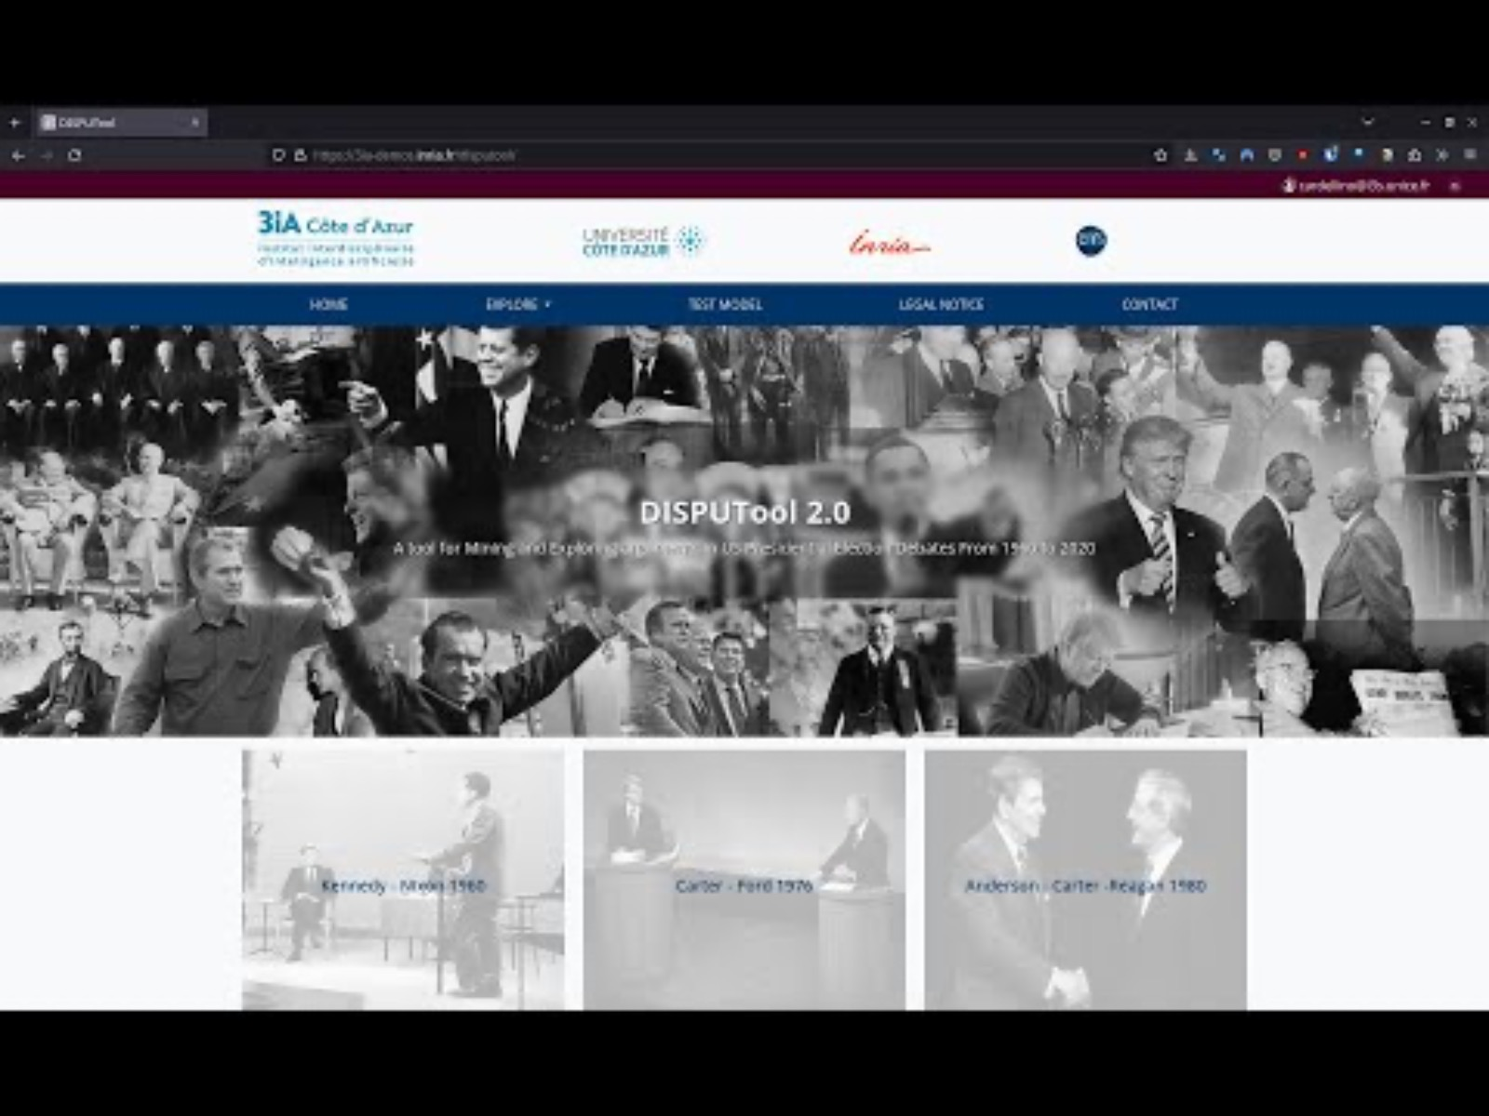
DISPUTool 2.0 Demo

Slide 73
Adapting DISPUTool for Deliberative Democracy
Part of the ORBIS Project.
We are studying how to extrapolate the AI models from DISPUTool to deliberative democracy.
The final objective is to analyse the arguments proposed by citizens within the European Union.
It provides many challenges.
Anonymous data collection, less formal set ups, less structured scenarios.

Slide 74
Agenda
13:30 - 13:00 | Part 2 Demonstration and hands-on experience of a series of technological tools that address this challenge | BCause: Reasoning for change: A Structured and Decentralised Discussion System for Distributed Decision Making DemocraticReflection: collective intelligence platform to harness real-time audience feedback over live debates DISPUTool: A tool for Mining and Exploring arguments in US Presidential Election Debates, adapted to deliberative democracy debates AI4Gov: A Self-Explained Visualisation Workbench: a Bias Detection Toolkit that empowers policymakers, researchers, and practitioners with understanding tailored for detecting biases in AI systems ORBIS: On the development of a dashboard for deliberation analytics

Slide 75
A Self-Explained Visualization Workbench: A Bias Detection Toolkit that empowers policymakers, researchers, and practitioners with understanding tailored for detecting biases in AI systems
Join at menti.com | use code 7976 2214
Contributed Partners: JSI & UPRC

Slide 76
Components and Use Cases
Join at menti.com | use code 7976 2214
Visualization Workbench (T4.4),
Bias Detector Toolkit (T4.1),
Adaptive Analytics Framework & Policy-Oriented AI & NLP Algorithms (Question Answering Service, Time Series Analyser & Predictive Analytics) (T4.3)
Use Cases to be supported​
IRCAI Top 100 projects (JSI) - Visualization Workbench, Bias Detector Toolkit​
OECD policy documents analysis (JSI) - Visualization Workbench, Question Answering Service​
Parking tickets monitoring (VVV) - Visualization Workbench, Time Series Analyzer & Predictive Analytics​
Waste management - Pay As You Throw (PAYT) (VVV) - Visualization Workbench, Time Series Analyzer & Predictive Analytics

Slide 77
Project Use Cases
Join at menti.com | use code 7976 2214
A short description
JSI Use Cases​
IRCAI Top100 projects. It is an IRCAI initiative, funding projects to address problems related to the SDGs by using Artificial Intelligence. The final goal is a checklist for both Reviewers and Applicants of the program, but as a first step, mostly concerning the Applicants, a catalogue of projects that aim to mitigate bias in every step/phase of ML model design and training. Stakeholders: Applicants to the IRCAI Top 100 Projects.
OECD documents. is collection of various national AI policies and strategies. Here we will showcase the functionality of an extractive Q/A and multilingual chatbot, that provides information directly from these papers. How different problems are solved through different policies and countries? How bias is tackled in different countries? Stakeholders: policymakers, public authorities, researchers, general public, journalists.
VVV Use Case​s
Parking Tickets: Predicting an area of interest where it is more likely that a specific traffic violation might occur in order to allocate resources (e.g., municipal policy). Interactive density map box visualizing the geospatial evolution in time of a specific traffic violation. Stakeholder: policymaker, worker in the public authority.​
Waste Management: Routing optimization of garbage trucks. Based on the current data predict the fill-levels of the bins for the next N hours and then perform routing optimization of the fleet of garbage trucks to collect all the bins that will exceed (based on the predicted values) a certain level of amount of garbage. The optimization can be either based on time (minimize time needed to fulfill the task) or on distance (minimize the distance covered by each vehicle). Stakeholder: policymaker, worker in the public authority.​
Notes:
Top100:
Various interactions and activities: for applicants both education, solutions to mitigate bias and quantification; for reviewers quantification
Added value: tools directly for ML developers, quantification for both applicants and reviewers.
OECD documents:
Various interactions and activities: chatbot (later also causal graphs) for policy makers
Added value: policy makers find best practices; journalists, general public get info on policies in a more approachable manner

Slide 78
Data to be used in the demonstrator
Join at menti.com | use code 7976 2214
Subtitle
JSI Use Cases​
IRCAI Top100 – catalogue part
Literature overview. Update: yes, option to add new tools
OECD documents
Policies collected at OECD.​ Update: (bi)annual
VVV Use Case​
Parking Tickets:
VVV historical data (traffic violations issued by Municipal Police and Helleninc Police in the Municipality of VVV).​ Update: No
Waste Management:
VVV historical data (bins ID, timestamp, fill level) + bins equipped with sensors. Update: daily
Notes:
Provide data-related information (i.e. which data are used, how have these been obtained, from which sources, if and when they are updated, etc)

Slide 79
Demonstration
Join at menti.com | use code 7976 2214
Subtitle
Notes:
Anything you like to present. Prepare a Live Demo, but also have a video/recording as Plan B

Slide 80
THANK YOU FOR YOUR ATTENTION
Join at menti.com | use code 7976 2214

Slide 81
Agenda
13:30 - 13:00 | Part 2 Demonstration and hands-on experience of a series of technological tools that address this challenge | BCause: Reasoning for change: A Structured and Decentralised Discussion System for Distributed Decision Making DemocraticReflection: collective intelligence platform to harness real-time audience feedback over live debates DISPUTool: A tool for Mining and Exploring arguments in US Presidential Election Debates, adapted to deliberative democracy debates AI4Gov: A Self-Explained Visualisation Workbench: a Bias Detection Toolkit that empowers policymakers, researchers, and practitioners with understanding tailored for detecting biases in AI systems ORBIS: On the development of a dashboard for deliberation analytics

Slide 82
ORBIS On the development of a dashboard for deliberation analytics
Join at menti.com | use code 69 06 83 8
Nikos Alimpertis, Nikos Karacapilidis, Ioannis Livieris
Novelcore

Slide 83
CHALLENGES _
Augment levels of trust, transparency and credibility in democratic policy-making processes.
A meaningful and effective joining-up of bottom-up citizen-led initiatives and top-down policy making.
Enhance participation, openness, pluralism and civic engagement in using digital democracy solutions.
New ways for citizens to exercise their social responsibility and be engaged in democratic discussions about how contemporary crises and conflicts can be prevented, mitigated and resolved.
Digital democracy models and solutions that can effectively scale up at all levels (local, regional, national, global).

Slide 84
Join at menti.com | use code 69 06 83 8
From transcripts to semantically-rich,
machine interpretable discourses
aggregation (clustering and summarization) mechanisms
ML/NLP pipelines for actionable knowledge mining
deliberation structuring and visualization to improve awareness and engagement

Slide 85
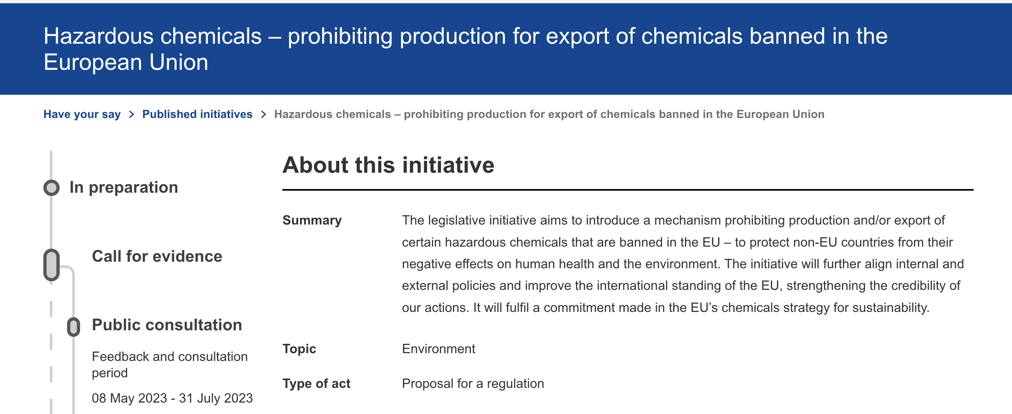
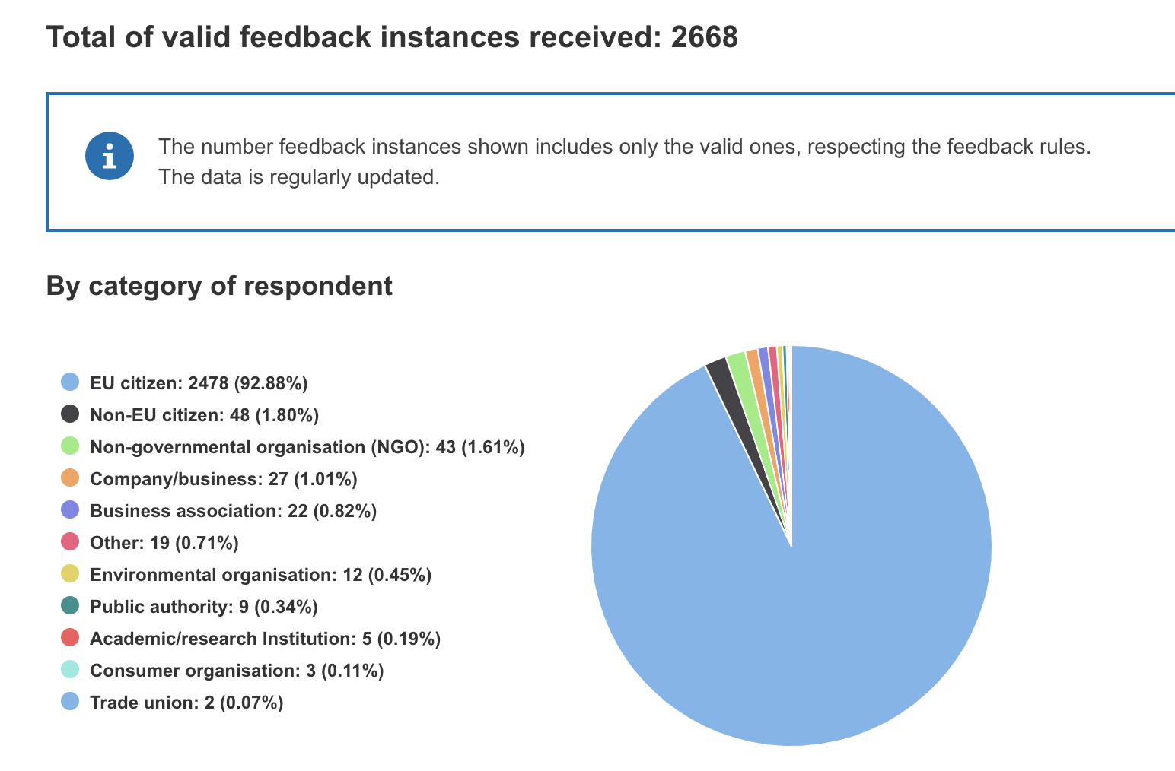
Example 1
Join at menti.com | use code 69 06 83 8
https://ec.europa.eu/info/law/better-regulation/have-your-say/initiatives/13750-Hazardous-chemicals-prohibiting-production-for-export-of-chemicals-banned-in-the-European-Union/feedback_en

Slide 86
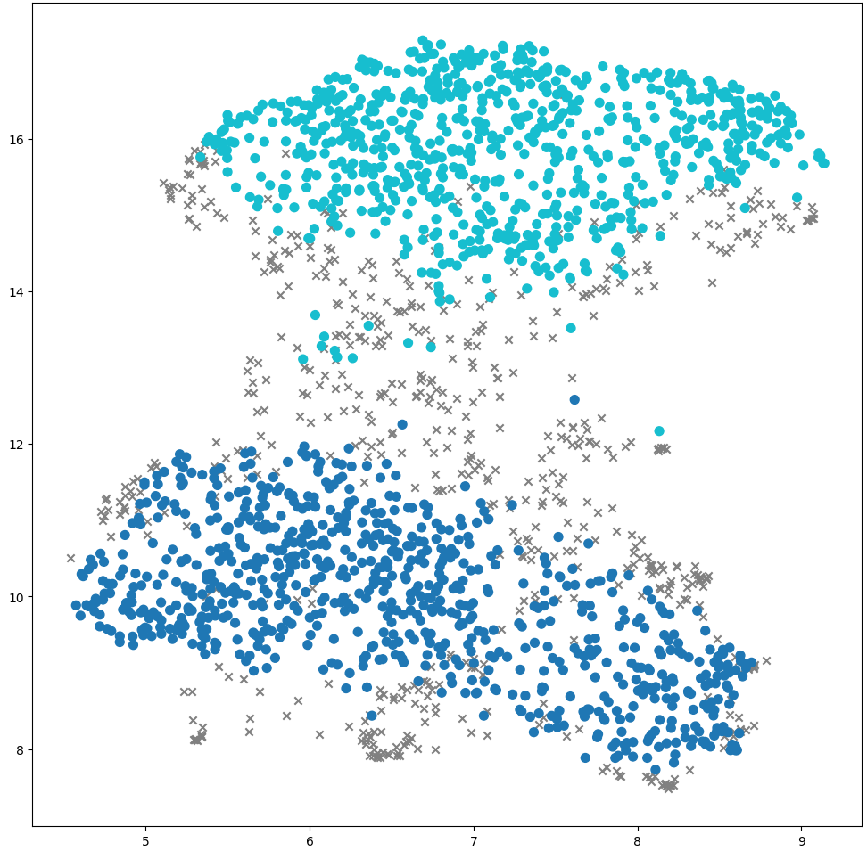
Join at menti.com | use code 69 06 83 8
Title: Protecting Health and Environment: EU's Ban on Hazardous Pesticide Exports
Summary: Export of toxic pesticides is disastrous for bees, biodiversity and the planet, says German politician. Pesticides are linked to cancer, reproductive problems and neurodegenerative diseases, as well as to the death of bees. The export of toxic pesticide corresponds to a policy of double standards, writes Matthias teutsch.
Keywords: ban pesticides, european citizen hazardous pesticides, luca genova european pesticide legislation, pesticide exports, toxic pesticides benefits countries, pesticide export, european pesticides, european pesticide manufacturers, export pesticides, pesticide pollution

Slide 87
Join at menti.com | use code 69 06 83 8
Title: Ethical Responsibility: Prohibiting European Chemicals from Endangering Other Countries
Summary: It is immoral to ban products that are dangerous to human health and the environment and authorise them to other countries. It would be desirable to prohibit european companies from producing banned chemicals worldwide. The ban on production for export of banned chemicals is a claim that i would like not to have made: how does we inflict pollution on people in ‘distant’ countries that we do not accept at home?'
Keywords: ban chemicals, toxic products, export chemicals, other countries chemicals, dangerous pollutants, harmful chemicals, environmental chemicals, environmental poisons, dangerous environmental poisons, dangerous chemical chemicals

Slide 88
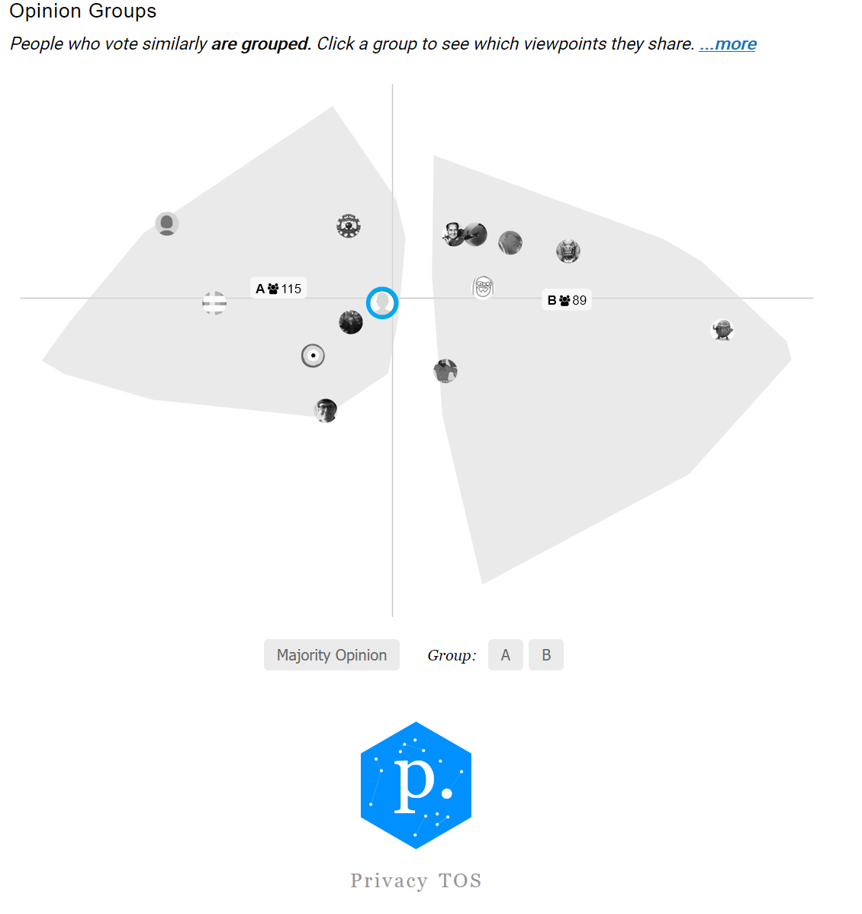
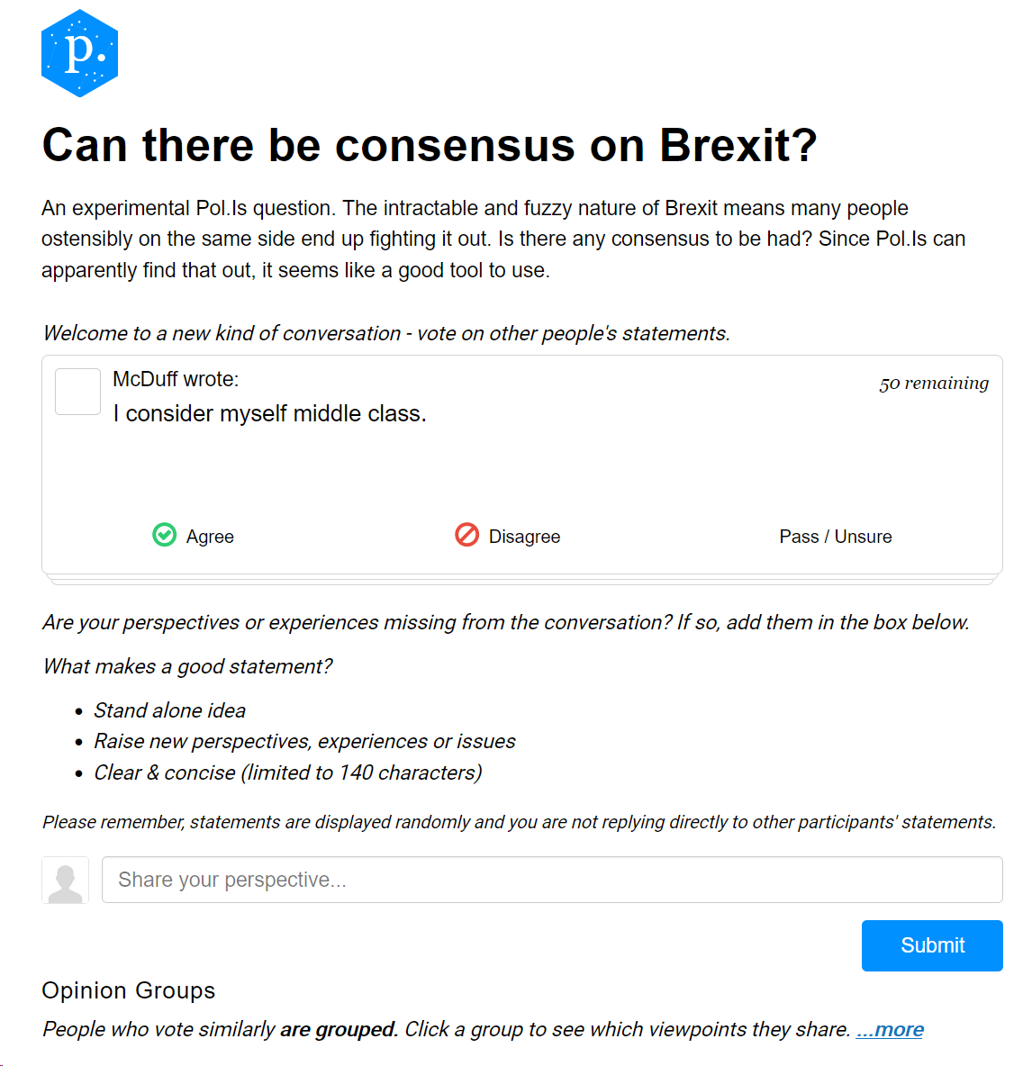
Example 2
Join at menti.com | use code 69 06 83 8
https://pol.is/7wmvbjcjhp

Slide 89
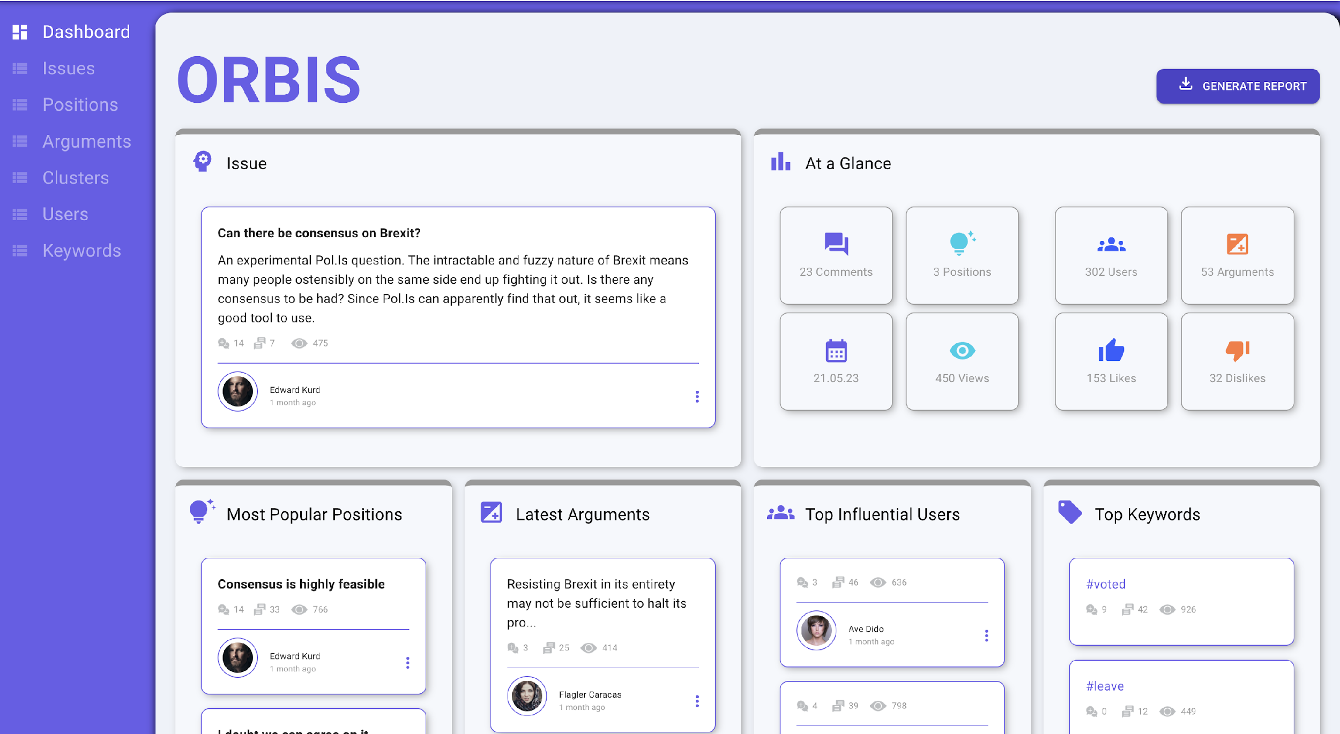
Join at menti.com | use code 69 06 83 8

Slide 90
Join at menti.com | use code 69 06 83 8

Slide 91
Join at menti.com | use code 69 06 83 8

Slide 92
Join at menti.com | use code 69 06 83 8

Slide 93
Clustering
Join at menti.com | use code 69 06 83 8
Summarization
Extractive approaches
Abstractive approaches
Hybrid approaches
A clustering algorithm (K-Medoids) discovers thematic text clusters.
Dimensionality reduction (e.g. UMAP, T-SNE).
Another algorithm (LLM-based) clusters items upon their content.
Topic modeling
BERTopic
LLM-based

Slide 94
Our AI-based approach
Join at menti.com | use code 69 06 83 8
Building a human-machine partnership that will augment the creativity and collaborative strengths of humans
The equal and documented participation of all with consultative and structured discourse can restore the faith of citizens in democracy and in social structures

Slide 95
Thanks for your attention
https://orbis-project.eu/

Slide 96
Agenda
13:30 - 13:00 | Part 2 Demonstration and hands-on experience of a series of technological tools that address this challenge | BCause: Reasoning for change: A Structured and Decentralised Discussion System for Distributed Decision Making DemocraticReflection: collective intelligence platform to harness real-time audience feedback over live debates DISPUTool: A tool for Mining and Exploring arguments in US Presidential Election Debates, adapted to deliberative democracy debates AI4Gov: A Self-Explained Visualisation Workbench: a Bias Detection Toolkit that empowers policymakers, researchers, and practitioners with understanding tailored for detecting biases in AI systems ORBIS: On the development of a dashboard for deliberation analytics QnA Session

Slide 97
Questions and Answers session – how to participate
QnA
Mentimeter survey
For feedback on the presented tools
Join at menti.com | use code 69 06 83 8
ai-big-data-and-democracy-task-force@googlegroups.com

Slide 98
Agenda
 |  | Please complete the feedback form https://forms.office.com/Pages/ResponsePage.aspx?id=VdQuDq-WAEG-06jl_ZgWhZ-TAYxFwktIut65chnYYehUNFlJUFc2R0xWSk9GSkFMMDhBTTRESkc4WC4u or https://forms.office.com/e/17W2VL8xKC

Slide 99
Agenda
ai-big-data-and-democracy-task-force@googlegroups.com

