Slide 1
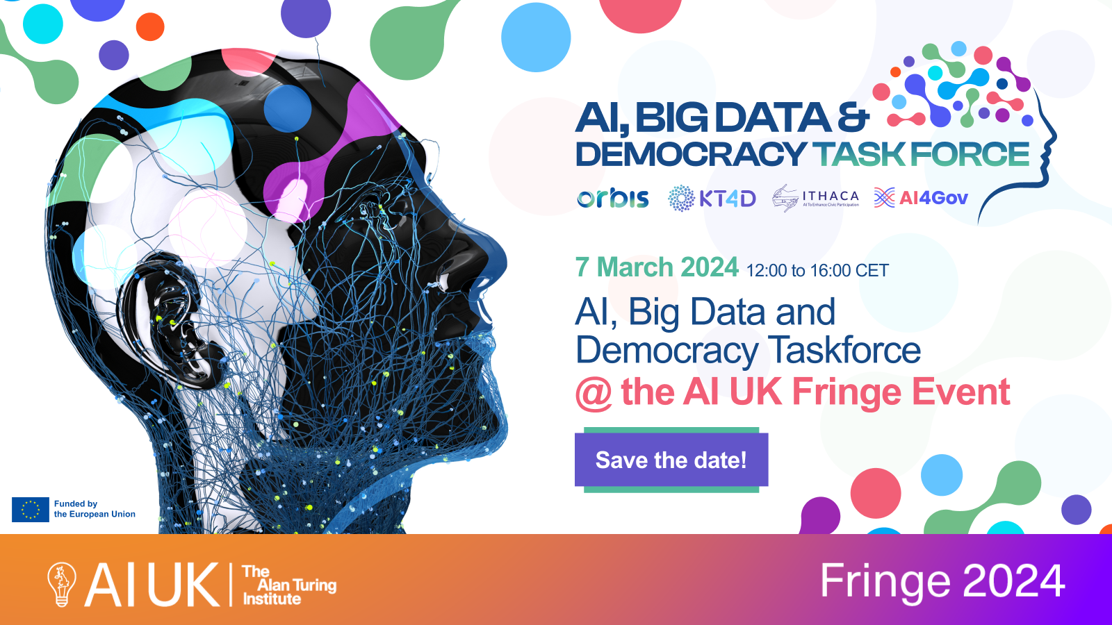
11:00 – 15:00

Slide 2
Recording notice
Please note, this session will be recorded.
Only speakers will be recorded and any question and answer sessions recorded will be anonymised.
If you have any concerns, please speak to the events team on arrival or contact them via email.

Slide 3
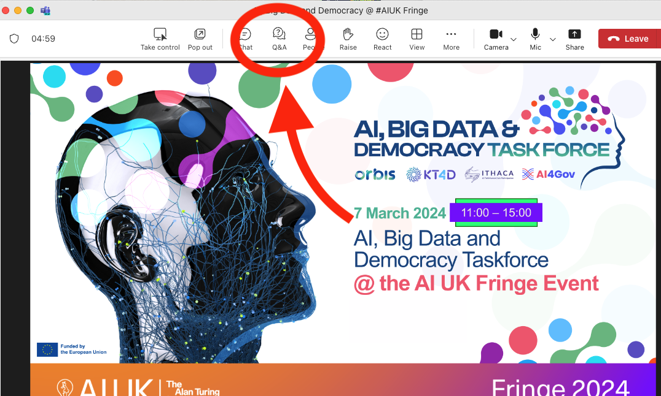
How to participate
QnA
For questions during the presentations to be discussed at the panel discussion
Mentimeter survey
You will be given time to reflect and fill before the panel discussion
Join at menti.com | use code 7976 2214

Slide 4
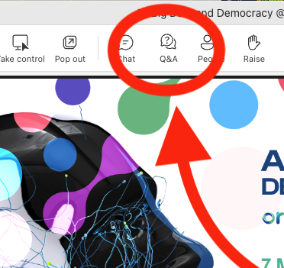
Agenda
11:00 - 12:30 | Part 1 A theoretical grounding on conducting responsible AI in democratic processes, via a series of short keynotes Post your feedback in QnA | AI and Democracy: Risks and Opportunities Prof Keith Hyams, University of Warwick, UK Online Deliberation: Bridging Theory and Practice Prof Anna De Liddo, Open University, UK Trustworthy and Explainable AI in Policy Making: How can we enhance trustworthiness, fairness and explainability of the modern AI by enabling humans to reason about the outcomes of AI-based models. Fabiana Fournier, IBM Research, Israel Aiming for participatory democracy and the inclusion of vulnerable groups: challenges, aspirations and lessons Michael Bedek and Maria Zangl, University of Graz

Slide 5
A Theoretical Grounding For Responsible AI Use In Democratic Processes
Professor Keith Hyams
University of Warwick
KT4D

Slide 6
4 key questions
Part 1 / A Theoretical Grounding For Responsible AI Use
Join at menti.com | use code 7976 2214
1. What is democracy?
2. What is valuable about democracy?
3. What risks does AI pose to these values?
4. How can AI enhance democracy?

Slide 7
What is Democracy?
Part 1 / A Theoretical Grounding For Responsible AI Use
Join at menti.com | use code 7976 2214
Democracy as self government.
Representative
Participatory
Deliberative
Values realised to different extent in different forms

Slide 8
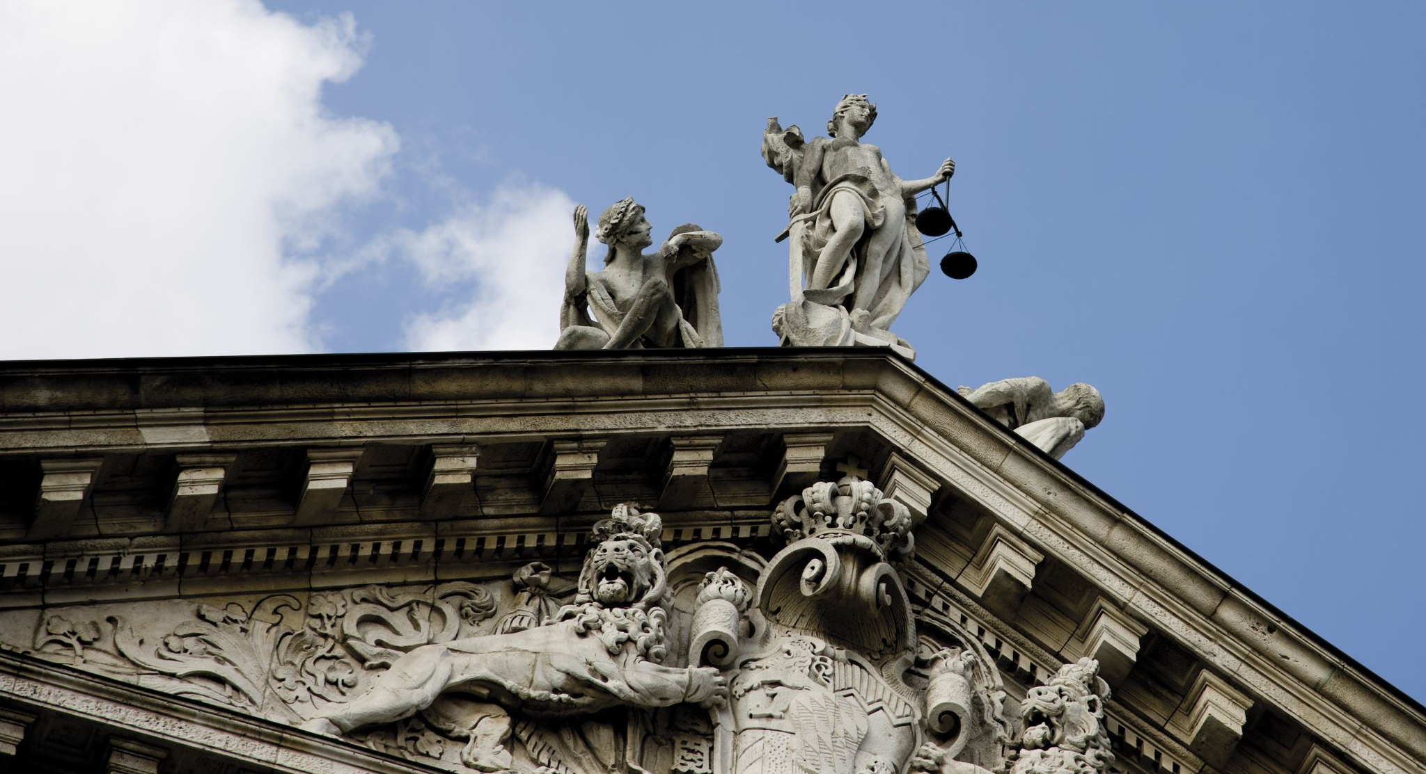
The Values of Democracy
Part 1 / A Theoretical Grounding For Responsible AI Use
Join at menti.com | use code 7976 2214
Equality – of participation
Autonomy – of decision making
Freedom – from domination
Transparency – of justificiation
Justice – in outcomes

Slide 9
How does AI threaten these values?
Part 1 / A Theoretical Grounding For Responsible AI Use
Join at menti.com | use code 7976 2214
Equality
AI bias, corporate power, epistemic injustice, voter suppression (EagleAI)
Autonomy
Manipulation of opinions, misinformation, user profiling
Freedom
Data collection and privacy concerns, AI-assisted surveillance
Transparency
Delegation of decisions, non-explainable AI
Justice
Access to benefits of AI, unfair processes to unfair outcomes, algorithmic sorting (filter bubbles)

Slide 11
How does AI threaten these values?
Part 1 / A Theoretical Grounding For Responsible AI Use
Join at menti.com | use code 7976 2214
Equality
AI bias, corporate power, epistemic injustice, voter suppression (EagleAI)
Autonomy
Manipulation of opinions, misinformation, user profiling
Freedom
Data collection and privacy concerns, AI-assisted surveillance
Transparency
Delegation of decisions, non-explainable AI
Justice
Access to benefits of AI, unfair processes to unfair outcomes, algorithmic sorting (filter bubbles)

Slide 12
How can AI enhance these values?
Part 1 / A Theoretical Grounding For Responsible AI Use
Join at menti.com | use code 7976 2214
Equality
Promote accessibility and participation
Autonomy
Assist deliberation
Freedom
Reduction of administrative hurdles
Transparency
Make data available and understandable
Justice
Ease of data gathering and use

Slide 13
How to reap the benefits while avoiding the risks?
Part 1 / A Theoretical Grounding For Responsible AI Use
Join at menti.com | use code 7976 2214

Slide 14
No easy solution or technical fix Regulation yes – AI in general and in democracy But broader issues of ownership and power OpenAI as a warning shot AI risks not isolated from broader democratic challenges Starts with awareness and participation
Part 1 / A Theoretical Grounding For Responsible AI Use
Join at menti.com | use code 7976 2214

Slide 15
Part 1 / A Theoretical Grounding For Responsible AI Use
Join at menti.com | use code 7976 2214
Professor Keith Hyams
k.d.hyams@warwick.ac.uk

Slide 16
Agenda
11:00 - 12:30 | Part 1 A theoretical grounding on conducting responsible AI in democratic processes, via a series of short keynotes | AI and Democracy: Risks and Opportunities Prof Keith Hyams, University of Warwick, UK Online Deliberation: Bridging Theory and Practice Prof Anna De Liddo, Open University, UK Trustworthy and Explainable AI in Policy Making: How can we enhance trustworthiness, fairness and explainability of the modern AI by enabling humans to reason about the outcomes of AI-based models. Fabiana Fournier, IBM Research, Israel Aiming for participatory democracy and the inclusion of vulnerable groups: challenges, aspirations and lessons Michael Bedek and Maria Zangl, University of Graz

Slide 17
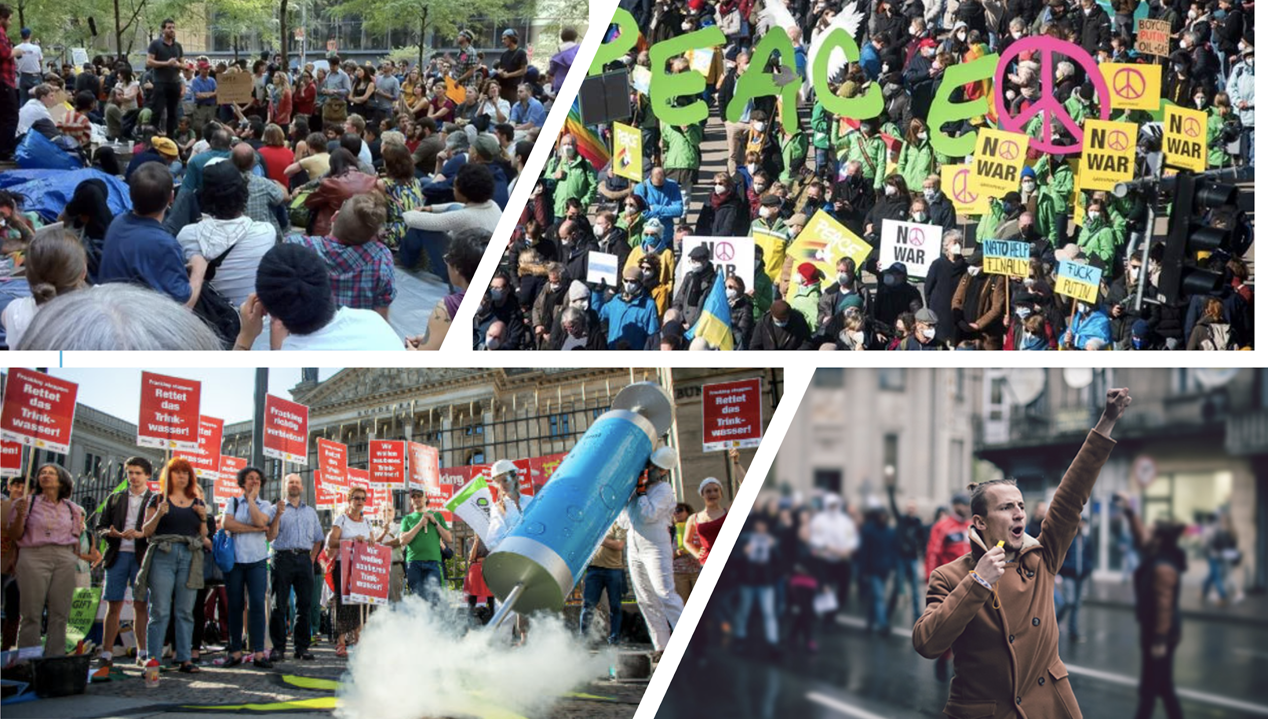
Online Deliberation: Bridging Theory and Practice
Prof. Anna De Liddo
Knowledge Media Institute
The Open University, UK
March 7th 2024
Online Streaming
Fringe 2024

Slide 19
Anna De Liddo Professor of
Human-Computer Interaction
Alberto Ardito
Senior Web Developer
Retno Lasarati
PhD Student Explainable AI
Lucas Anastasiou
PhD Student Argument Mining
Riccardo Pala
Web Developer
Lady Kitty Chisholm
PhD Student Belief Change in Adults at Work
Michelle Bachler
Senior Project Officer

Slide 20
Problem
Profound luck of institutions, norms, methods and tools to engage the public in healthy deliberation on issues of public interests
WE MISS THE RIGHT SOCIO-TECHNICAL SPACES TO ENGAGE CITIZEN IN DELIBERATIVE DEMOCRACY

Slide 21
Deliberative Democracy
Deliberative democracy is a form of democracy in which deliberation and public consultation with citizens are central to democratic decision-making.
Deliberative democracy holds that, for a democratic decision to be legitimate, it must be preceded by authentic deliberation, not merely the aggregation of preferences that occurs in voting.
Authentic deliberation is deliberation among decision-makers that is free from distortions of unequal political power, such as power a decision-maker obtained through economic wealth or the support of interest groups.
In non elitist deliberative democracy (populist deliberative democracy), principles of deliberative democracy apply to groups of lay citizens who are empowered to make decisions.

Slide 22
Deliberative Democracy
In its 1927 book The Public and Its Problems American philosopher John Dewey states that "what people need in a modern democracy is common knowledge, including the means to discuss and judge" (Dewey 1927).
Proponents of deliberative democracy argue that, as a result of deliberation, people arrive at less biased and more reflective political judgements (Dryzek et al. 2019).

Slide 23
Deliberative Democracy
“Deliberative democracy scholars come from multiple disciplines, some are theorists, some are resolutely empirical.
Some wish to observe and interpret the world, others to change it.
Deliberative democracy is a reform movement as well as an academic activity (Gastil and Levine 2005).
Most visibly, this movement is manifested in micro-level democratic innovations that involve the participation of ordinary citizens (Smith 2009).”
Selen A. Ercan & John S. Dryzek (2015) The reach of deliberative democracy, Policy Studies, 36:3, 241-248, DOI: 10.1080/01442872.2015.1065969

Slide 24
The Public Sphere
A portion of the public sphere comes into being in every conversation in which private individuals assemble to form a public body. (Habermas, 1974, p. 49)
“the notion of the public sphere is at the center of participatory approaches to democracy. The public sphere is the arena where citizens come together, exchange opinions regarding public affairs, discuss, deliberate, and eventually form public opinion.”
https://assets.publishing.service.gov.uk/media/57a08b45e5274a27b2000a69/PubSphereweb.pdf

Slide 25
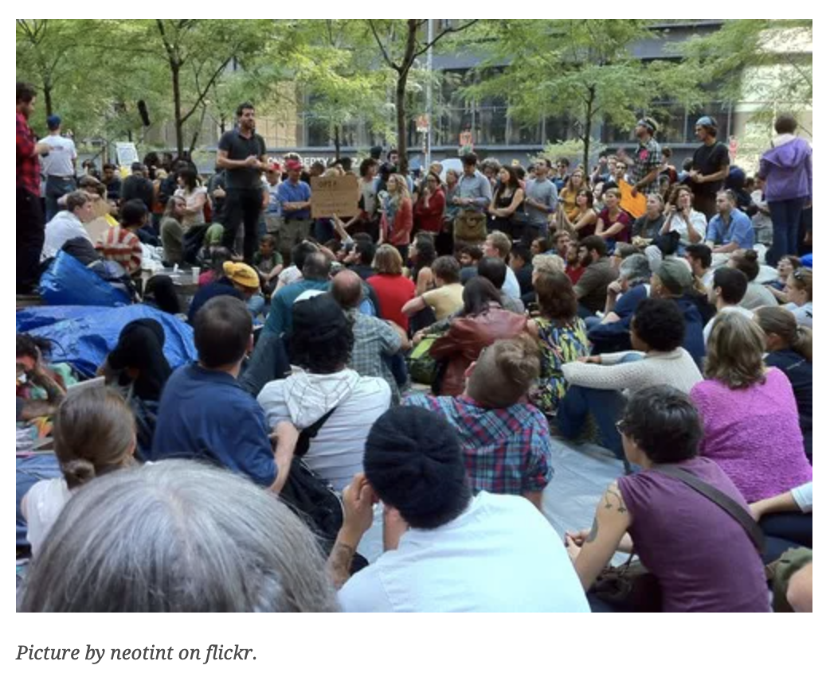
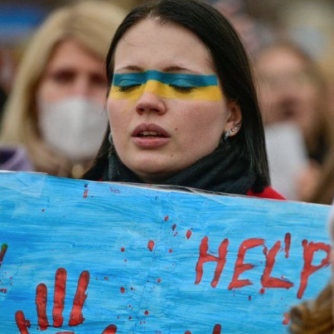
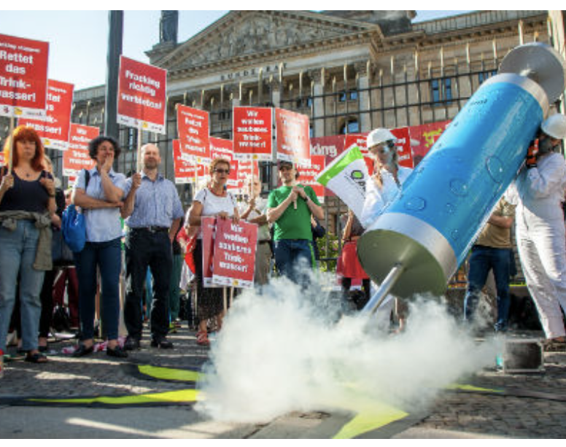
Current events worldwide show that we miss the right socio-technical spaces to collectively discuss, think critically and makesense of complex situations.
Deliberation is the careful discussion before decision, and it can be defined as the thorough dialogical assessment of the reasons for and against a measure before a decision is made.
When teams, people or organisations are geographically distributed these thorough conversations cannot happen face-to-face, with people sitting in the same room.
Social Media are the standard solution for organisations to carry out online deliberation in large distributed groups. Research evidence though shows that those systems are highly inappropriate to achieve effective deliberation, since they are:
Rudimental in the way they structure online discussion data,
not designed to support decision making, and
often produce polarisation, division and conflict.
At all societal levels we lack tools for effective large-scale deliberation.
Problem:
Online Deliberation Support is poor

Slide 26
Setting the Problem: Technical Dimension
The discussion spaces that we see on the Web today are flawed
are rudimental in the way they structure data
lack of content quality and variety
scarcely support evidence-based reasoning
lack features to enhance personal understanding and situational awareness
Notes:
the dialogue systems that we see on the web today are rudimental in the way they structure data, they scarcely support evidence-based reasoning, and lack features to enhance personal understanding and situational awareness. This motivates our investigation of new conversational platforms that are specifically designed to support these key capabilities of effective deliberation and decision making.
New tools are needed to bridge political debate across community platforms. Within the online deliberation research community, this has been done by creating new online deliberation technologies for public debate.

Slide 27
SETTING THE PROBLEM:
SOCIAL/ORGANISATIONAL DIMENSION
… and produce well known negative socio-technical effects, such as
‘echo chambers” and the activation of biased information dynamics (Ditto & Lopez, 1992; Taber & Lodge, 2006)
Homophily and Lack of content variety (Huckfeldt & Sprague, 1995, Mutz & Martin, 2001).
polarisation, division and conflict (Sunstein, 2018; Golbeck et al., 2017; Matias et al., 2015, Binder et al., 2009)
degrade the quality, balance and safety (Golbeck, 2017; Guntuku, 2017) of online discourse, up to undermining social tolerance (Mutz 2002)

Slide 28
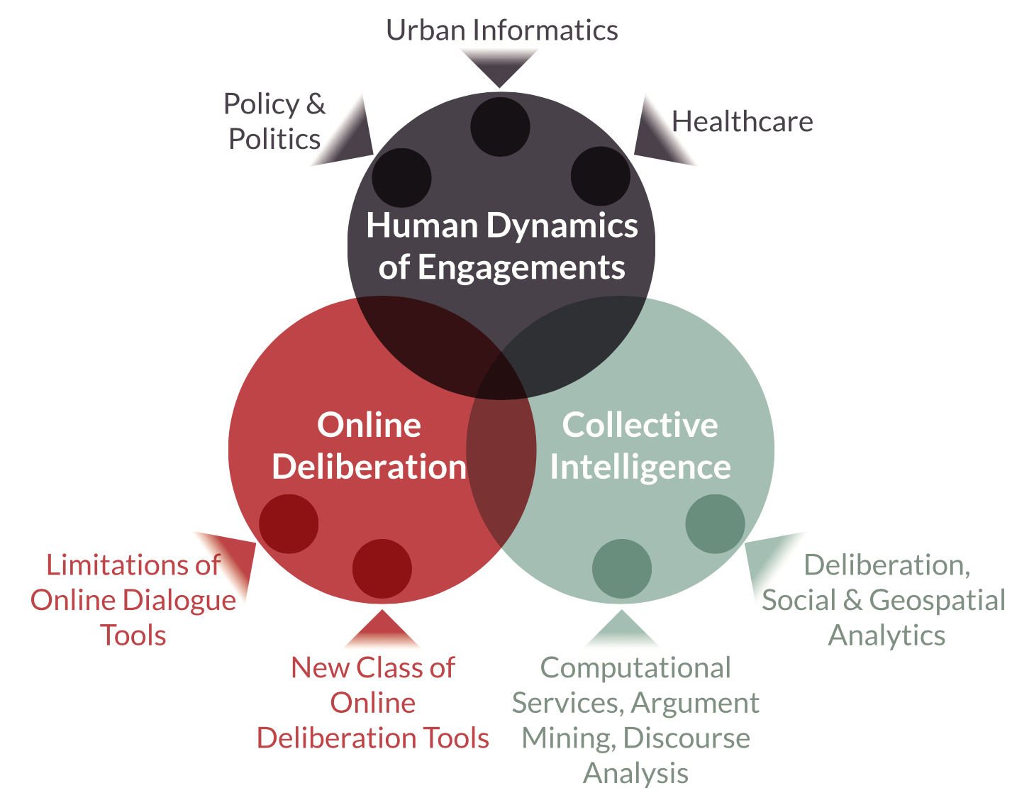
Contested Collective Intelligence
(De Liddo 2012)
Notes:
Ultimately, the objective of our research is enabling ideation and deliberation at unprecedented scales while allowing many voices to contribute to effective, unbiased, democratic conversations that lead to intelligent group behaviors and social change.

Slide 29
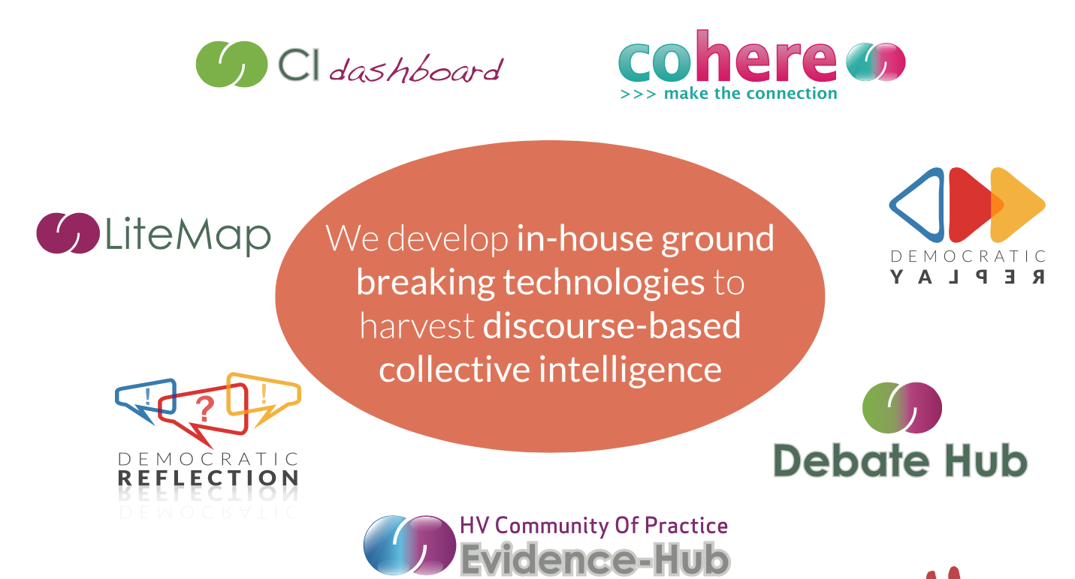
Notes:
What all these technologies have in common is the capability to facilitate sensemaking, critical thinking and a better understanding of complexity
In this talk I am going to focus on one of this technology and thy to argue and demonstrate the important of ritical thinking as a skill for democracy and peace building education.

Slide 30
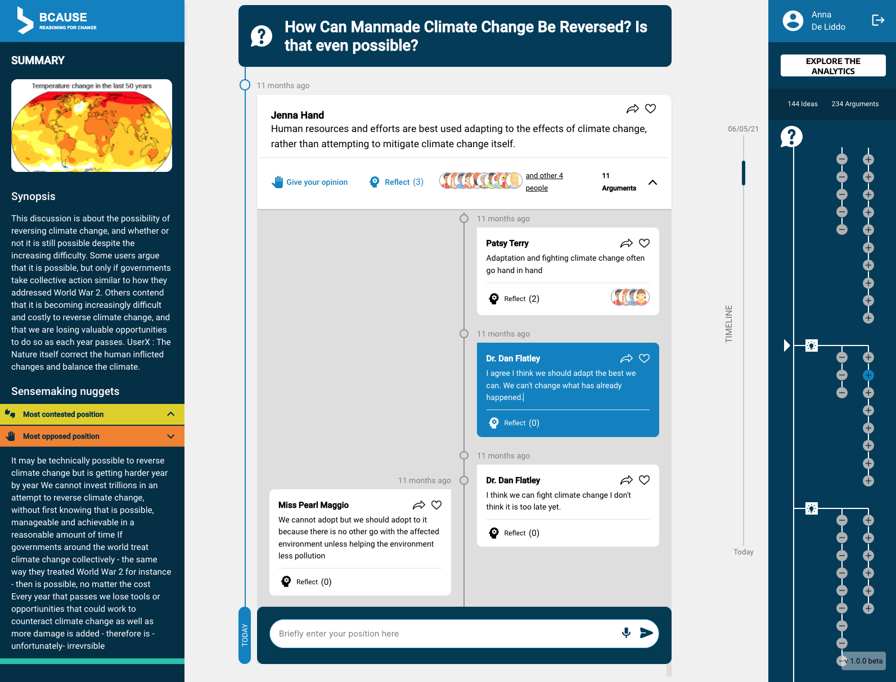
Improved Accessibility
New intuitive User Interfaces for structured online discussion
providing the many benefits of large-scale argumentation systems while avoiding the “cognitive leap” barrier.
developing tools and incentive structures that help users to contribute to “apparently” unstructured discussions that can then lead into structured deliberation data and processes.
Notes:
Intuitive interface using a timeline representation to conversational contribution, but enabling structured contribution in form of argument pro and con.
Additional right navigation three that help navigation of long conversation and highlight the structure of the discussion in terms of ideas propose and their pro and cons
Textual summary and focus of attention recommendations on the left for newcomers to get a sence of the state and progress of the discussion and help them focus attention where the conversation needs it more.

Slide 31
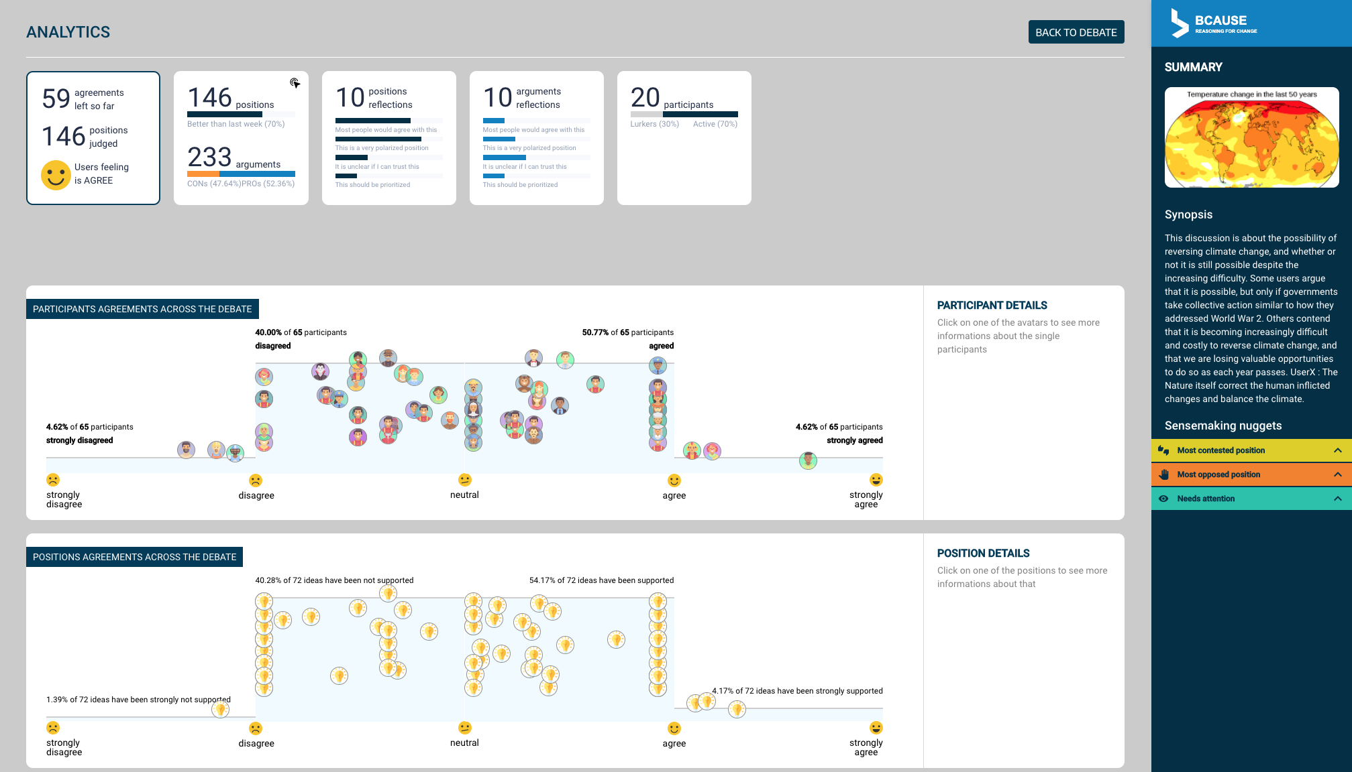
Advanced Visual Analytics for Sensemaking
Improved sensemaking of the online discussion and transparency of analytical processes
Sophisticated analytics and visualization tools can summarize large deliberation data as well as automatically generate personalized alerts that help users learn and contribute as effectively as possible.

Slide 32
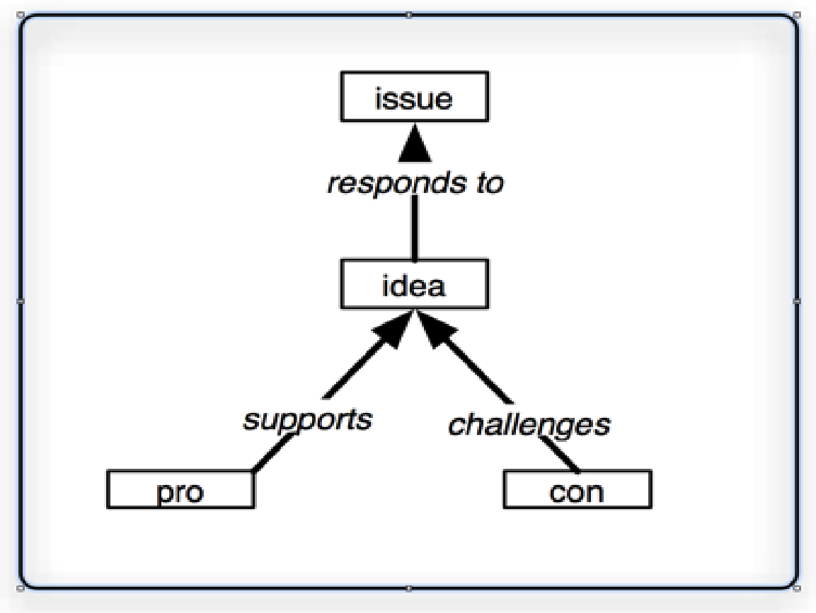
A Common Data Model: simplified IBIS
IBIS adds a simple semantic structure to the online conversation and has demonstrated to be usable by lay people in different public debates (Iandoli et al. 2009, Klein 2012).

Slide 33
RESULTS FROM LAB EXPERIMENTS AND REAL LIFE APPLICATIONS SHOW…

Slide 34
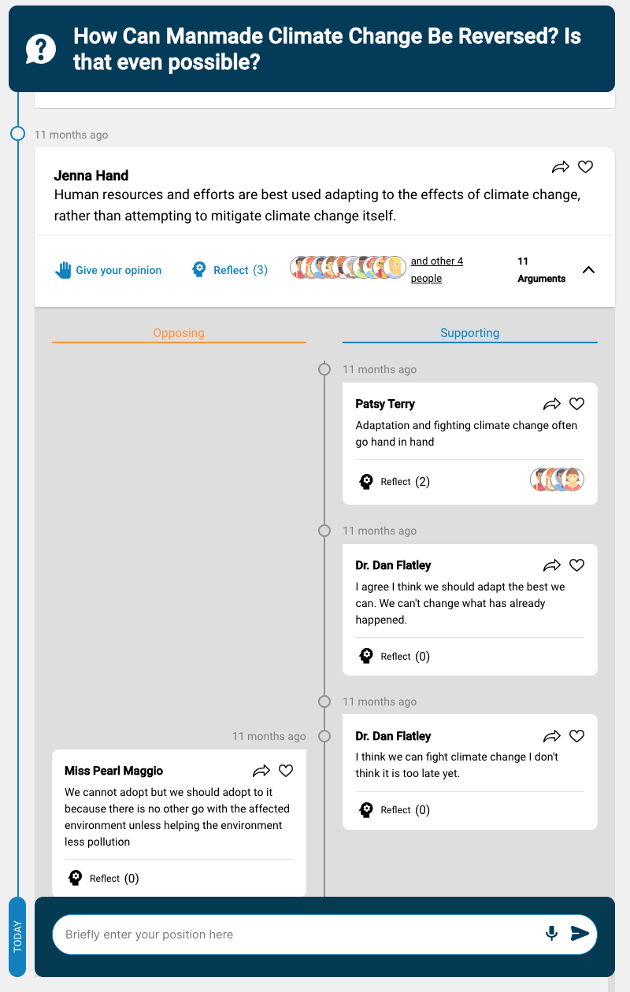
Argumentation structuring does NOT reduce engagement
Argumentative interface can be equally usable and engaging as normal unthreaded discussions interfaces.
Argumentative interface can be as accessible as common Social Media and do not require any training

Slide 35
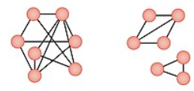
Argumentation structuring IMPROVES group cohesion and REDUCES conversational silos
This means that argumentation structuring has a positive impact on the reduction of platform islands of discussion and brings the group to discuss more cohesively

Slide 36
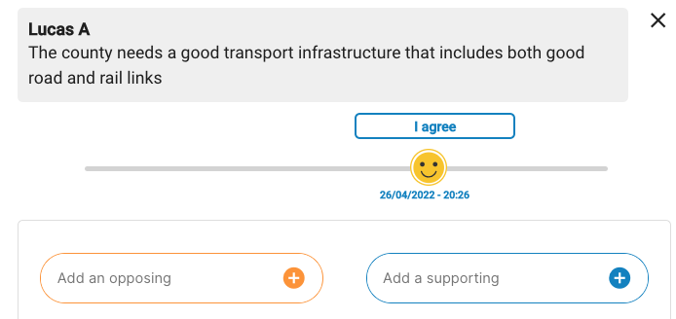
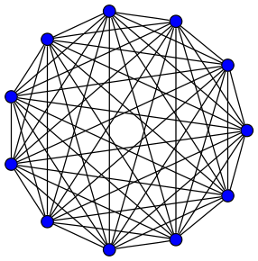
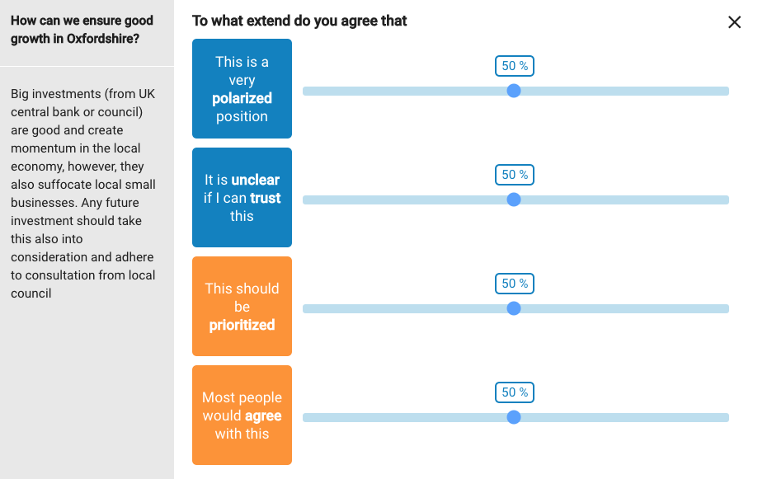
Reflections Enhancements produce better social interaction than appreciative only feedback
Reflection Enhancements produce a better social interaction coverage, more reciprocity (everyone speaks to everyone), and produce better connected social networks compared to appreciative only feedback solutions.

Slide 37
Automated Reporting improves understanding of the discussion
Anastasiou, L. and De Liddo, A., 2021, May. Making Sense of Online Discussions: Can Automated Reports help?. In Extended Abstracts of the 2021 CHI Conference on Human Factors in Computing Systems (pp. 1-7)

Slide 38
Advantages of Argumentation-based Deliberation Systems
help communities be much more systematic and complete in their deliberations about complex and contentious topics (Iandoli et al 2010),
enhance evidence based dialogue, build common ground, favour constructive rather than confrontational discourse (Kriplean et al., 2014),
support the development of shared understanding of complex problems (Conklin and Begeman 1988), and
improve the quality of online argumentation (De Liddo et al. 2012; Arniani et al. 2016; Kaye 2002; Hathorn and Ingram 2002).
Notes:
Argumentation based Issue-centric systems (such as Deliberatorium, Cohere, DebateGraph, The Evidence Hub), where people interact by building deliberation maps, that are made up of interlinked questions, answers and arguments.

Slide 39
Current limitations of Argumentation-based Deliberation Systems
lack intuitive interfaces for contributing to online dialogue without hindering the natural flow of a conversation,
require a cognitive leap from users to participate and change of mindset toward evidence-based reasoning
Fail to scale
requires a level of idea formalisation that comes at extra costs for the users (Shipman and Marshall 1999).
Lack support for sensemaking and idea assessment
Centralised data storage
Notes:
Issue-centric systems (such as Deliberatorium, Cohere, DebateGraph, The Evidence Hub), where people interact by building deliberation maps, that are made up of interlinked questions, answers and arguments.
.

Slide 40
HORIZON-CL2-2022-DEMOCRACY-01-02 -
The future of democracy and civic participation
https://cordis.europa.eu/project/id/101094765
This project has received funding from the European Union's Horizon Europe Framework Programme under grant agreement No 101094765.
”

Slide 41
ORBIS responds to the profound lack of dialogue between citizenship and policy making institutions, by providing a theoretically sound and highly pragmatic socio-technical solution to enable the transition to a more inclusive, transparent and trustful Deliberative Democracy in Europe.
VISION:
AUGMENTING PARTICIPATION, CO-CREATION, TRUST AND TRANSPARENCY IN DELIBERATIVE DEMOCRACY AT ALL SCALES

Slide 42
How Can We Scale Deliberative Democracy? How can Technology Help?
ORBIS will shape and support new democratic models that are imagined and developed through deliberative democracy processes that are digitally mediated.
These are processes of structured, inclusive and large-scale societal dialogue, which are built through strong civic engagement.

Slide 43
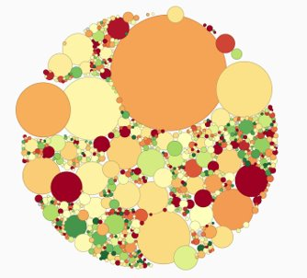
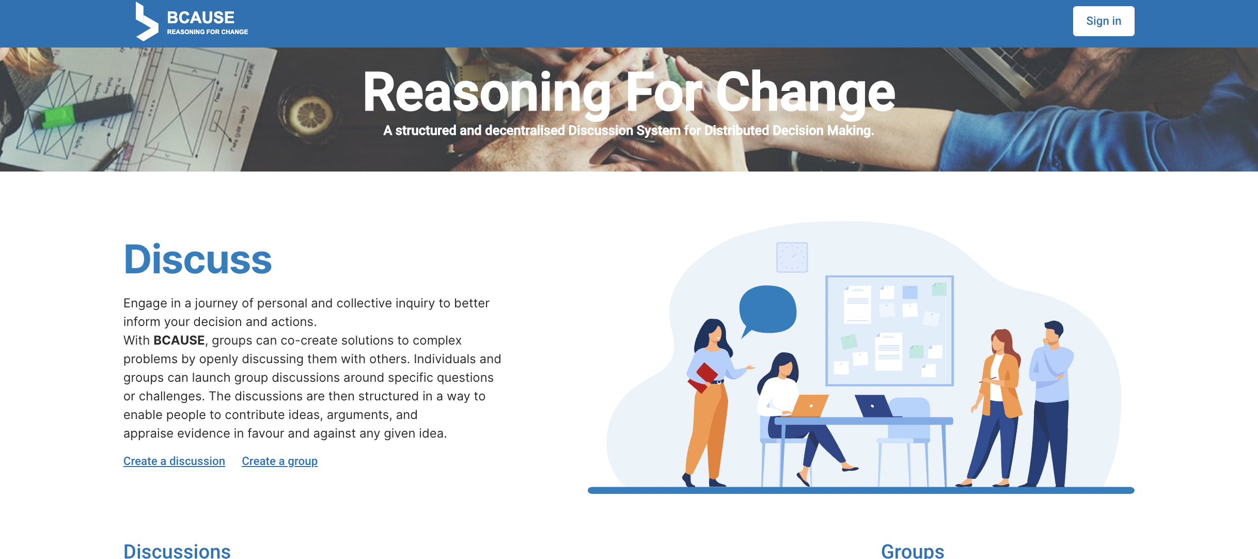
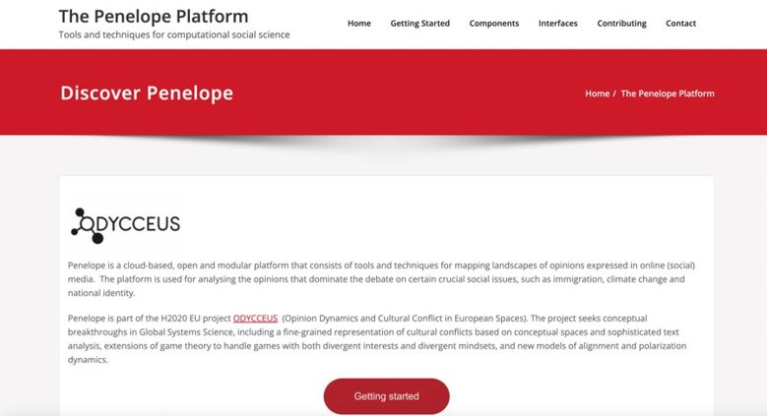
State of the Art Deliberative Democracy Innovations

Slide 44
13 Partners= 4 Universities, 5 Usecase partners (local Institutions and Civic Society Org) and 4 SME

Slide 45
5 Key Civic Tech Innovations
A user-friendly and AI-boosted Digital Democracy platform that augments Deliberative Participation at scale;
Argument and social knowledge mining, aggregation and visualization mechanisms for large-scale participation and deliberation process.
Awareness and explanation services to improve trust and transparency between citizens and policy makers.
Novel ML/NLP pipelines for actionable knowledge discovery and informed decision/policy making
New socio-technical mechanisms for conflict mediation in large-scale argumentative deliberation.
and demonstrated measurable impact of such innovations in real-world settings.

Slide 46
6 Pilots to Experiments with Scaling Deliberative Democracy Tools, Methods and Processes
6 USE CASES
REIMAGINING THE BUILDING BLOCKS OF DEMOCRACY
TEENS FOR DEMOCRACY
YOUNG THINKERS AND EU DECISION-MAKERS
REIMAGINING THE BUILDING BLOCKS OF DEMOCRACY
TEENS FOR DEMOCRACY
YOUNG THINKERS AND EU DECISION-MAKERS
FUTURE4CITIZENS
TRANSITION MECHANISMS FOR A DEMOCRATIC CITY
ALLIANCE FOR ENTREPRENEURSHIP AND DEVELOPMENT IN WESTERN GREECE
EUROPE4CITIZENS
Scale | International | Initially European, to scale out to a global level | European | Initially national, to scale out to a European level | Initially local, to scale out to the national and EU level | Initially regional, to scale out to the national level
Distinctive character of the case | Deliberation on the building blocks of democracy; leveraging the experience of DCF and its external network including partners such as the newDemocracy Foundation, Future Consensus Institute, Konrad Adenauer Foundation, Sapienship, and The Bertelsmann Foundation; to be broadly promoted through the Athens Democracy Forum | Participation of teenagers (13-17 years old) in deliberative processes carried out within the municipal councils of 5 European municipalities; collaboration with Sapienship to set up an edutainment document on democracy that will be launched under the auspices of UNICEF | Young people engage in deliberative processes with high- level EU policymakers and leading experts in the field of Citizen Science and Public Participation; built on the successful Young Thinkers initiative carried out by CEPS; to be widely promoted through the annual CEPS Ideas Lab | Employment of RIE Innovative Narrative Methodology and a variation on SITRA’s Futures Frequency Workshop method to conduct a series of citizen dialogues; run by RIE in partnership with prominent foundations; focus on issues related to inequality and fiscal reform, and the role of innovation in realizing SDGs | Inclusion of less skilled and marginalized segments of local civil society and group of activists; participants of multicultural origin, high percentage of young and elderly residents, institutionalization of deliberative processes between civil society and local authority; focus on urban planning issues | Deliberations at the regional level involving diverse types of stakeholders; positive attitude of stakeholders to wide and inclusive participatory processes on innovation actions; focus on social and female entrepreneurship issues
TRANSITION MECHANISMS FOR A DEMOCRATIC CITY
ALLIANCE FOR ENTREPRENEURSHIP AND DEVELOPMENT IN WESTERN GREECE

Slide 47
Conclusion and Future Research Challenges

Slide 48
Deliberation as Fundamental Democratic Right
Democratic rights and requirements, both in political science and in computer science research, often include deliberation as a fundamental requirement of citizens, but the most widely adopted deliberative democracy practices around the world today do not reach the many, involve high costs, and rarely take advantage of the collaboration and engagement of the computing community, particularly advances in online deliberation.
What can we do about this as scientists, academics, practitioners parents and world citizens?

Slide 49
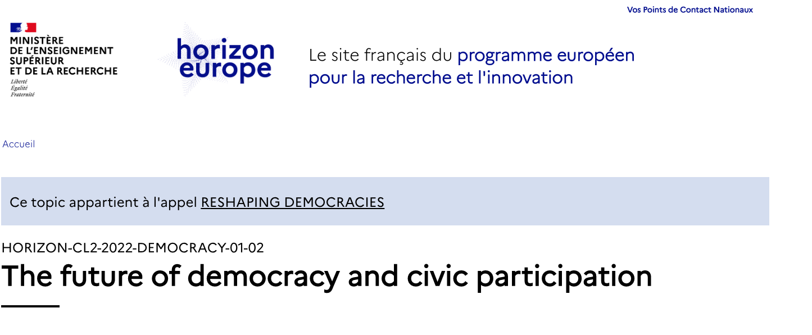
A Vibrant Time for Civic Tech

Slide 50
If we want to support people’s capability to question assumptions and think critically, we need to design spaces for personal reflection and sensemaking.
Sensemaking processes need human–machine support
New tools are needed to bridge debates across community platforms: a visual analytics and data science approach
Notes:
In response to the scepticisms toward new media capability to support people’s critical thinking rather than promote polarization of pre-existing groups and opinions. Our research into new sensemaking technologies and hypervideo shows that new media can effectively support democratic deliberation and crucially provide new tools for citizens
to detect and make sense of manipulations, check facts versus speculations, gain new insights, and confidently inform their political choices.
Recent advances in research on argument mining [39, 40] and automatic detection of fake news [62] are starting to shape a near future in front of us in which machine analysis will be able to assist human assessment of complex political debates and dynamics.
New tools are needed to bridge political debate across community platforms.

Slide 51
Interfaces for Sensemaking and Minimal Meaningful Participation
Real Time Analytics, Argument Mining, Fact Checking and
Human Machine Annotation
a pervasive challenge for building CI platforms is balancing a critical tension between:
The need to structure and curate contributions from many people in order to maximise the signal-to-noise-ratio and provide more advanced CI services
versus permitting people to make contributions with very little useful indexing or structure
How can visual and responsible artificial intelligence enhance and scale collective intelligence?
Notes:
Recent advances in research on argument mining [39, 40] and automatic detection of fake news [62] are starting to shape a near future in front of us in which machine analysis will be able to assist human assessment of complex political debates and dynamics.

Slide 52
Interfaces for DECENTRALISATION, Explicability and Conversational Intelligence To improve Trust and Accountability of Machine Predictions
CI works best when it is transparent
participants want to understand how their contributions are integrated and must be given access to visible expressions of analytics processes.
Users want autonomous control of their data and identity
On the other hand, the complexity of the underlying process can also scare participants away, and much raw data from analytics is hard to interpret without training
Notes:
CI works best when it is transparent
How do we explain the causal relation of data science inferences and machine predictions.

Slide 53
THANK YOU FOR LISTENING!
Please fell free to contact me at anna.deliddo@open.ac.uk

Slide 54
Agenda
11:00 - 12:30 | Part 1 A theoretical grounding on conducting responsible AI in democratic processes, via a series of short keynotes | AI and Democracy: Risks and Opportunities Prof Keith Hyams, University of Warwick, UK Online Deliberation: Bridging Theory and Practice Prof Anna De Liddo, Open University, UK Trustworthy and Explainable AI in Policy Making: How can we enhance trustworthiness, fairness and explainability of the modern AI by enabling humans to reason about the outcomes of AI-based models. Fabiana Fournier, IBM Research, Israel Aiming for participatory democracy and the inclusion of vulnerable groups: challenges, aspirations and lessons Michael Bedek and Maria Zangl, University of Graz

Slide 55
Trustworthy and Explainable AI in Policy making: How can we enhance trustworthiness, fairness, and explainability of the modern AI by enabling humans to reason about the outcomes of AI-based models
Part 1 / Trustworthy and Explainable AI
Join at menti.com | use code 7976 2214
Dr. Fabiana Fournier
IBM Research - Israel
Notes:
Hello, my name is Fabiana Fournier and I am a senior researcher in the IBM Research lab in Israel.
My presentation will address the question: Trustworthy and Explainable AI in Policy making: How can we enhance trustworthiness, fairness, and explainability of the modern AI by enabling humans to reason about the outcomes of AI-based models.

Slide 56
CityBot: free parking brochure
Part 1 / Trustworthy and Explainable AI
Join at menti.com | use code 7976 2214
CityBot: Electric Vehicle Incentive Program
Join our new program to encourage residents to buy electric vehicles and receive a free parking permit!
Will you get it?
Why not?
Because for many years now, we learned that: “people not only utilize technological artifacts as tools, but also form social and trusting relationships with them” [Benbasat & Wand 2005]
I am not sure …
'We're excited to offer you a free parking as part of our initiative to promote electric vehicle ownership among residents. Joining our program not only helps you save on parking but also contributes to a greener city!'
That sounds great! How can I sign up and participate?
Fantastic! You can sign up through our city's official website. Don't miss out on this opportunity to make a difference and enjoy the benefits of electric vehicles.
Notes:
Let’s start with a simple example of a citybot of free parking brochure
<<READ>>
What changed? The user now trusts the system and therefore is receptive to the offer

Slide 57
Why do we need trust in AI-based systems?
Part 1 / Trustworthy and Explainable AI
Join at menti.com | use code 7976 2214
Foster adoption - Building trust in AI is essential for scaling up innovation and ensuring widespread acceptance and adoption of AI.
E.g., https://www.dnv.com/research/future-of-digital-assurance/building-trust-in-ai.html
Regulation - Consensus is beginning to appear regarding the need to regulate specific settings. There is a need to formalize a framework to guide companies and protect society.
E.g., EU AI Act
Our user study shows that trust it is not just a “moderator” of the quality of explanation, but affects the perceived explanation by the user
Notes:
WHY DO WE NEED TRUST IN AI-BASED SYSTEMS?
Foster adoption: Trustworthiness is a pre-requisite for the uptake and adoption of automated systems.
Regulation: Increasingly laws, regulations, and codes of conduct put a duty on organizations that make automatic decisions about their customers or users to provide them with an explanation of the “logic” associated with such decisions.
We carried out a user study on the quality of explanations generated by large language models such as ChatGPT. Our study shows that trust affects the perceived explanation. I will show later some of this work.

Slide 58
Part 1 / Trustworthy and Explainable AI
Join at menti.com | use code 7976 2214
Trustworthy AI
EXPLAINABILITY
FAIRNESS
SAFETY
AUDITABILITY
FEAS principle – Toreini at al. The Relationship between Trust in AI and Trustworthy Machine Learning Technologies. In Proceedings of the 2020 Conference on Fairness, Accountability, and Transparency
Notes:
There are many frameworks for trustworthiness. Toreini et al. proposed 4 aspects:
Fairness technologies focus on detection and prevention of discrimination and bias in different demographics
Explainability technologies focus on explaining and interpreting the outcome to the end users in a human manner
Auditability technologies focus on enabling third parties and regulators to supervise, challenge, or monitor the operation of the models.
Safety technologies focus on ensuring the operation of the model as intended in presence of active or passive malicious attacker.
WE focus on explainability in our work.

Slide 59
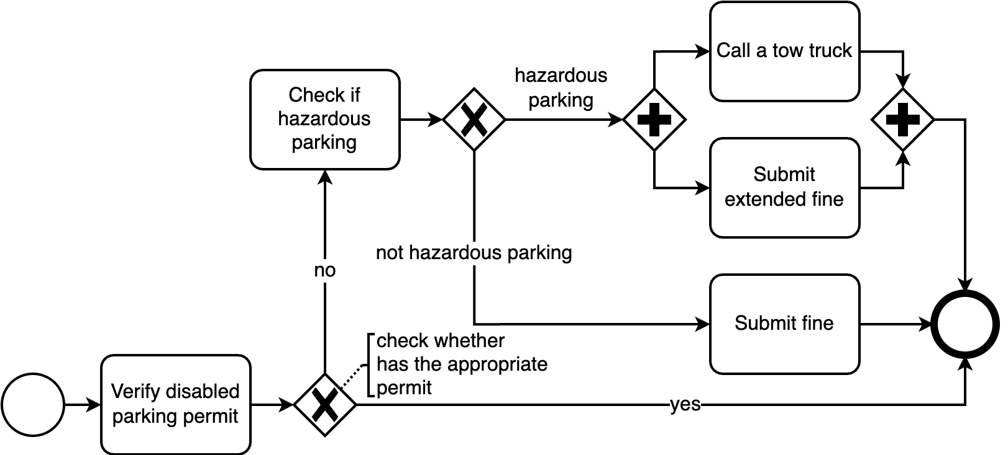
Part 1 / Trustworthy and Explainable AI
Join at menti.com | use code 7976 2214
How well can we address user questions related to conditions in business processes?
Why does the processing of fines in hazardous location take so long
Notes:
Our main interest is in explainability for business processes.
As an example, let’s look at a simple process of giving a fine ticket to a driver parking in a forbidden place. We will get to this scenario later, but in the meantime let’s assume the police officer would like to understand how he can expedite the process in hazardous places. In order to do so he asks “why does the processing of fines in hazardous places take so long”

Slide 60
What are the problems with the State-of-the-Art explainability for business processes?
Part 1 / Trustworthy and Explainable AI
Join at menti.com | use code 7976 2214
Many of the explanations fail to
express the business process model constraints,
include the richness of contextual situations that affect process outcomes,
reflect the true causal execution dependencies among the activities in the business process, or
make sense and be interpretable to human users
© 2023 IBM Corporation
‹#›
Notes:
Today this question cannot be fully answered.
This is due to the fact that Many of the state-of-the-art explanations fail to
express the business process model constraints,
(fail to) include the richness of contextual situations that affect process outcomes,
(fail to) reflect the true causal execution dependencies among the activities in the business process, or
make sense and be interpretable to human users

Slide 61
What are the problems with the State-of-the-Art explainability for business processes?
Part 1 / Trustworthy and Explainable AI
Join at menti.com | use code 7976 2214
Many of the explanations fail to
express the business process model constraints,
include the richness of contextual situations that affect process outcomes,
reflect the true causal execution dependencies among the activities in the business process, or
make sense and be interpretable to human users
Situation Aware eXplainability (SAX)
‹#›
Notes:
We introduce Situation-Aware eXplainability (SAX) as a new discipline that is capable of tackling these shortcomings

Slide 62
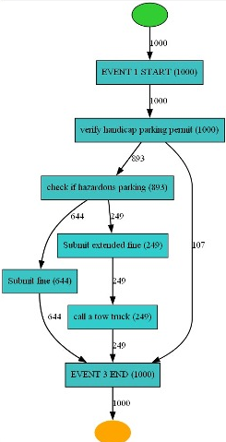
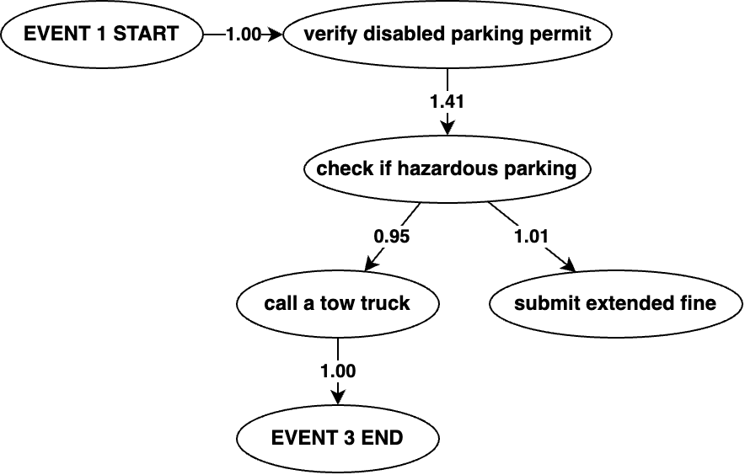
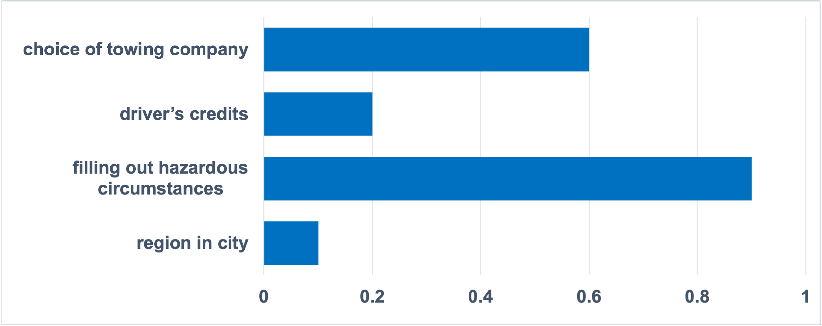
Part 1 / Trustworthy and Explainable AI
Join at menti.com | use code 7976 2214
SAX4BPM library – the idea “Form”, “Blend”, “Interpret” (FBI)
knowledge ingredients
causal knowledge
XAI knowledge
process knowledge
“Why does the processing of fines in hazardous location take so long?”
explanation
Large Language Model (LLM)
Notes:
The main idea is to blend different knowledge ingredients that tackle different aspects of the shortcomings previously seen and input them to a large language model (LLM) such as ChatGPT to generate explanations. The LLM generates a textual narrative articulating the reasons for the question in hand.
We named this method FBI – FORM, BLEND, and INTERPRET and developed the SAX4BPM library that implements it.
The process knowledge ingredient will address the process model constraints and contextual situations that affect process outcomes,
The causal model ingredient takes into account the true causal execution dependencies among the activities in the business process
The XAI knowledge ingredient reflects the relative importance of the attributes of the activities in the process

Slide 63
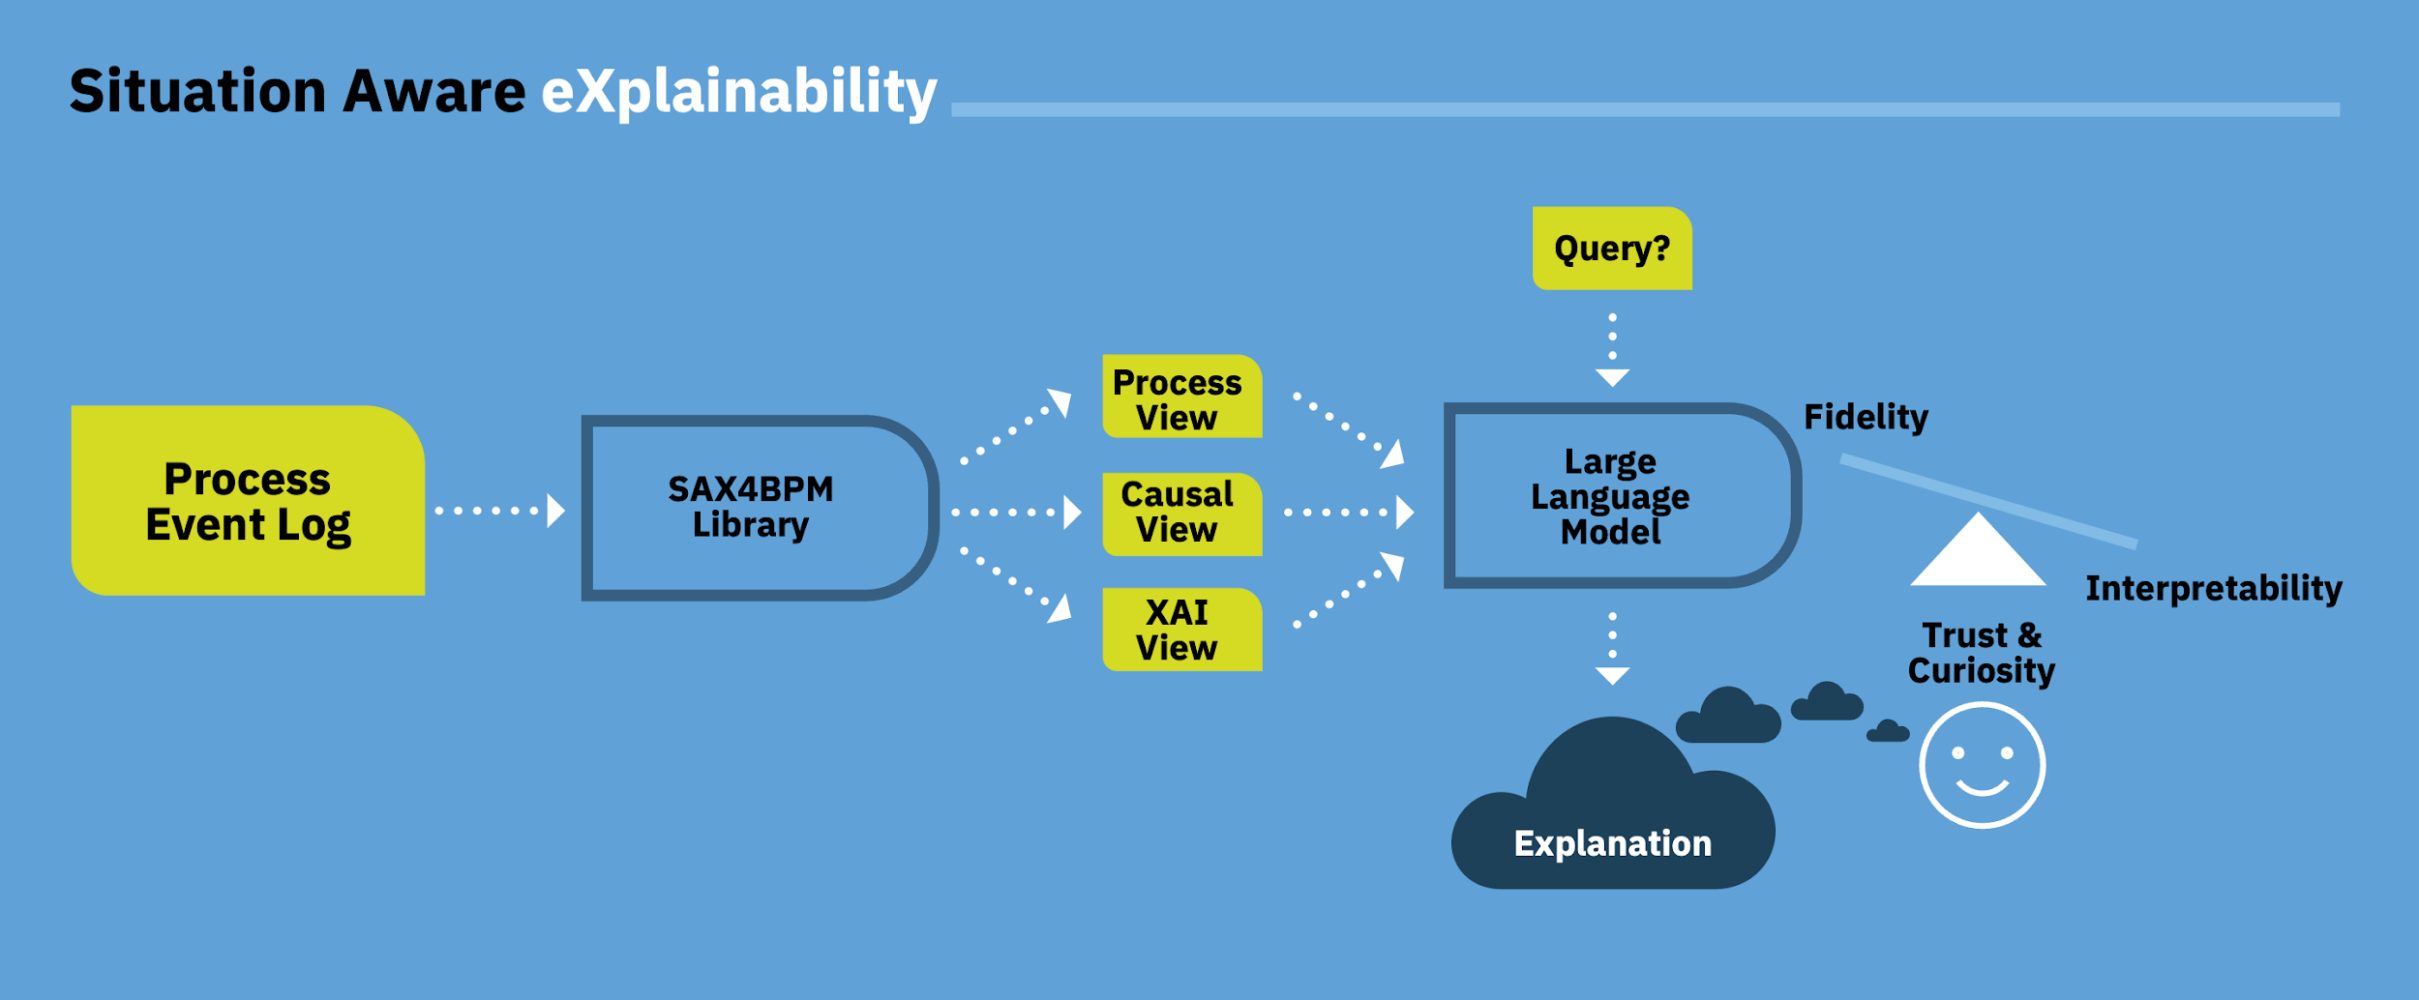
Part 1 / Trustworthy and Explainable AI
Join at menti.com | use code 7976 2214
SAX4BPM library – general approach
Notes:
As previously showed, this is the general approach, while we also developed a designated scale to assess the quality of the generated explanation by the LLM.
The input to our library is a process event log, that is, traces of process executions. By using the library set of services we produce 3 views: the process, the causal, and the XAI views. These are prompted to an LLM model that generates the explanation to a specific question. The explanation can be assessed in terms of fidelity and interpretability while taking also into account the trust and curiosity perceived by the user.

Slide 64
Part 1 / Trustworthy and Explainable AI
Join at menti.com | use code 7976 2214
SAX4BPM library – general approach
Beyond SOTA
Beyond SOTA
Beyond SOTA
Beyond SOTA
Notes:
As can be seen we extended the state-of-the-art in several aspects in our framework.

Slide 65
Part 1 / Trustworthy and Explainable AI
Join at menti.com | use code 7976 2214
SAX4BPM library – general approach
Synthesis of knowledge ingredients
Leveraging LLM for process explainability
Designated scale
Causal process discovery
Notes:
<<READ>>

Slide 66
Part 1 / Trustworthy and Explainable AI
Join at menti.com | use code 7976 2214
The future is here
SAX4BPM library
SAX4BPM services
Mining4Process
Causal4process
ContextEnrichment
X4Process
NLP4X
Time4Process (extension in the scope of the AI4GOV EU project)
‹#›
Notes:
The SAX4BPM library will be released to open source by the end of the AI4GOV EU project and includes the following set of services that tackle the knowledge ingredients presented before:
Mining4Process
Causal4process
ContextEnrichment
X4Process
NLP4X

Slide 67
Part 1 / Trustworthy and Explainable AI
Join at menti.com | use code 7976 2214
Notes:
Let’s watch now a very short video of the library

Slide 68
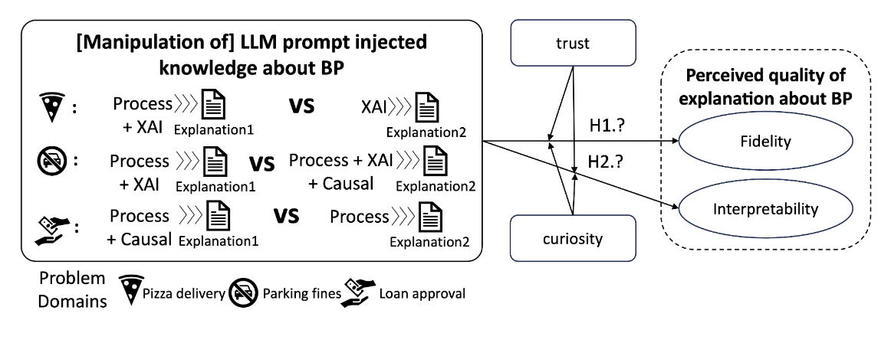
But…how well can large language models explain business processes? (1/4)
Part 1 / Trustworthy and Explainable AI
Join at menti.com | use code 7976 2214
We conducted a user study with 50 participants to test the quality of the generated explanations by the LLM
3 domains: pizza delivery, parking fines, and loan approval.
Notes:
As previously mentioned, we conducted a user study to assess the quality of the explanations generated by the LLM.
Our study consisted of 50 participants and 3 domains: pizza delivery, parking fines, and loan approval. The first two used synthetic data while the third use case used real data (available openly)
I will very briefly present the main insights of our study
We conducted several manipulations of our knowledge ingredients and presented a series of questions for the users to rate (using the Likert method). The goal was to test for fidelity and interpretability while taking also into consideration the aspects of trust and curiosity as perceived by the user.

Slide 69
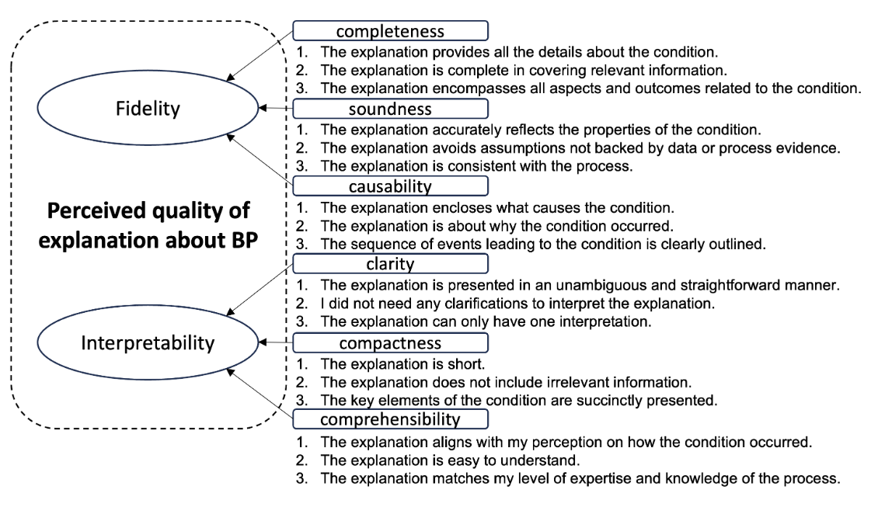
But…how well can large language models explain business processes? (2/4)
Part 1 / Trustworthy and Explainable AI
Join at menti.com | use code 7976 2214
Notes:
We carried out a literature survey and adopted fidelity and interpretability as two main latent constructs and defined six dimensions (3 under each construct).
In the slide you can see the final questions posted in the survey.

Slide 70
But…how well can large language models explain business processes? (3/4)
Part 1 / Trustworthy and Explainable AI
Join at menti.com | use code 7976 2214
Notes:
Given the nature of our controlled experiment with voluntary participation, we later also incorporated TRUST and CURIOSITY as potential covariates in our analysis.
This slide shows these two new dimensions along with the questions

Slide 71
But…how well can large language models explain business processes? (4/4)
Part 1 / Trustworthy and Explainable AI
Join at menti.com | use code 7976 2214
Results
Providing the LLM with additional knowledge about causal execution dependencies, or even just the temporal sequencing embedded in the process knowledge, can enhance the perceived fidelity.
However, this effect may diminish entirely when the user has low trust in the LLM. It may also lessen when the user has limited curiosity about the problem for which the explanation is sought.
Increased fidelity may come at the expense of reduced perceived interpretability.
Notes:
Our results show that the addition of knowledge ingredients indeed improve the perceived fidelity of the generated explanation.
However, in contrast to our initial hypotheses, that the addition of knowledge ingredients would improve both fidelity and interpretability, this was not our result. As illustrated in the slide, the addition of knowledge ingredient works towards improving the perceived fidelity of the explanation while compensating for the perceived interpretability of the explanation.
While our results clearly indicate that providing with additional knowledge can enhance the perceived fidelity, this effect may diminish entirely when the user has low trust in the LLM. It may also lessen when the user has limited curiosity about the problem for which the explanation is sought.

Slide 72
THANK YOU FOR YOUR ATTENTION
Part 1 / Trustworthy and Explainable AI
Join at menti.com | use code 7976 2214

Slide 73
Agenda
11:00 - 12:30 | Part 1 A theoretical grounding on conducting responsible AI in democratic processes, via a series of short keynotes | AI and Democracy: Risks and Opportunities Prof Keith Hyams, University of Warwick, UK Online Deliberation: Bridging Theory and Practice Prof Anna De Liddo, Open University, UK Trustworthy and Explainable AI in Policy Making: How can we enhance trustworthiness, fairness and explainability of the modern AI by enabling humans to reason about the outcomes of AI-based models. Fabiana Fournier, IBM Research, Israel Aiming for participatory democracy and the inclusion of vulnerable groups: challenges, aspirations and lessons Michael Bedek and Maria Zangl, University of Graz

Slide 74
ITHACA
artificial Intelligence To enHAnce Civic pArticipation
Aiming for participatory democracy and the inclusion of vulnerable groups:
challenges, aspirations and lessons
AI, Big Data and Democracy, 7/3/2024
Michael Bedek & Maria Zangl, University of Graz

Slide 75
Overview
PARTNERS (Country) | Main field of expertise
Konnektable Technologies Limited (IE) | Technology / AI
Centre for Research and Technology Hellas (EL) | Technology / AI
University of Patras (EL) | Technology / AI
Raising the Floor (BE) | Social & Cognitive Science
Stamadianos & Partners Law Firm (EL) | Law & Ethics
University of Graz (AT) | Social & Cognitive Science
MNLT Innovations IKE (EL) | Technology / AI
Software Imagination & Vision SRL (RO) | Technology / AI
PEDAL Consulting (SK) | Dissemination
Brasov Metropolitan Agency for Sustainable Development (RO) | Pilot City
City of Martin (SK) | Pilot City
Duration: 01/2023 – 12/2025
Funded by Horizon Europe
11 partners in the European Union
https://www.ithaca-project.eu/

Slide 76
Main Objectives
To explore and implement innovative ways to support civic engagement in local governance through the uses of AI and big data in an ethical and simple way
To involve citizens with different needs, ages and socio-economic backgrounds in the analysis and design of the use of AI-powered solutions for civic participation
To address critical aspects such as privacy, transparency, data management, barriers and opportunities for equal participation
To provide policy recommendations on how to ensure that philosophical, legal and ethical values are embedded in the development of AI-powered technologies that support civic participation

Slide 77
Why another platform for participatory democracy?
Better Reykjavik (https://betrireykjavik.is)
Decidim.Barcelona (https://www.decidim.barcelona/)
Maptionnaire (https://www.maptionnaire.com/)
Fluicity (https://get.flui.city/en)
….
A report that analyses and evaluates existing platforms can be found here: https://www.ithaca-project.eu/results/
Our very main focus is on the inclusion of
vulnerable & marginalized groups & individuals

Slide 78
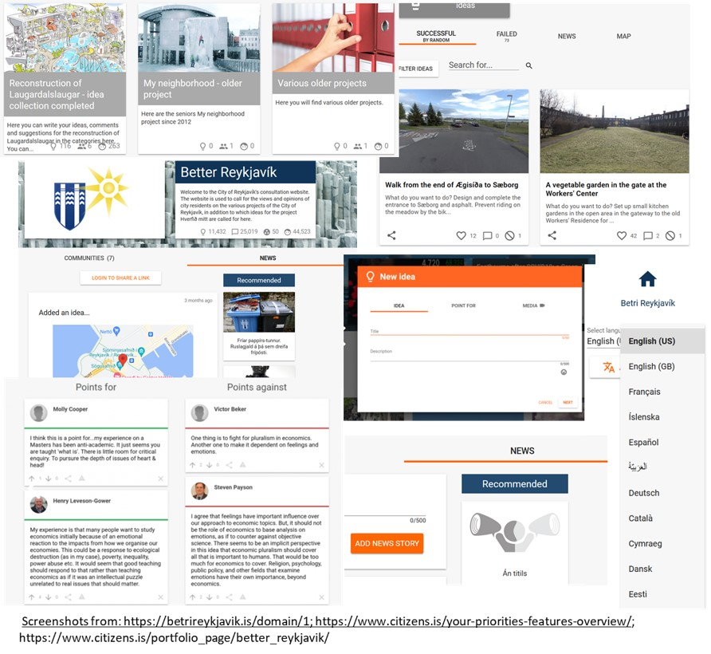
Example:
BetterReykjavik

Slide 79
Approach
vulnerability criteria / factors
vulnerable / marginalized social groups
low income
poor living conditions
precarious employment / (repeated) unemployed
lack of insurance
low educational background
limited educational opportunities
low digital literacy and/or particular need for support wrt to digital platforms
limited access to infrastructure / mobility
limited access to cultural program and information,
social isolation / loneliness
structural /systematical discrimination concerning participation
facing physical and/or verbal violence
Elderly / pensioners (e.g. 60+)
Younger / youth (i.e. 18-30)
Refugees & Migrants (e.g. Ukrainians, Syrians, etc.)
Romani people
People with physical disabilities
People with mental disabilities and/or problems (e.g. depression, addiction, etc.)
People in rural areas
Homeless people
People of colour
Women (Pregnant women &) women with young children
Families with many children (e.g. >3)
Single parents
LGBTQIA+

Slide 80
Approach
Identification of vulnerable & marginalized groups and vulnerability criteria
Refinement based on the social contexts in the two pilot cities Martin (Slovakia) and Brasov metropolitan area (Romania)
Enrichment by statistical & demographical data (e.g. Eurostat, national and regional data)
Recruiting „representatives“ from NGOs, Associations, Self-help groups, etc. who served as multipliers
Advertisment via local newspapers, media outlets and banner to enable the inclusion of the broader public

Slide 81
Selecting participants for the (two) AI Citizen Juries
Part I – Socio-demographics
Age, Gender, Highest educational attainment, Current occupation
Part II – Living and Work Situation
Type of household, Size of household, Number of people in the household, Access to internet, transport, amount of money at free disposal
Part III – Individual / Subjective Vulnerability
Affiliation to religious, linguistic, ethnic or other minority, Physical limitations, Mental limitations, Satisfaction with social environment and medical support, Opportunity to use cultural, social, or leisure facilities
🡪 As less questions as possible & as many as necessary to recruit diverse AI Citizen Juries

Slide 82
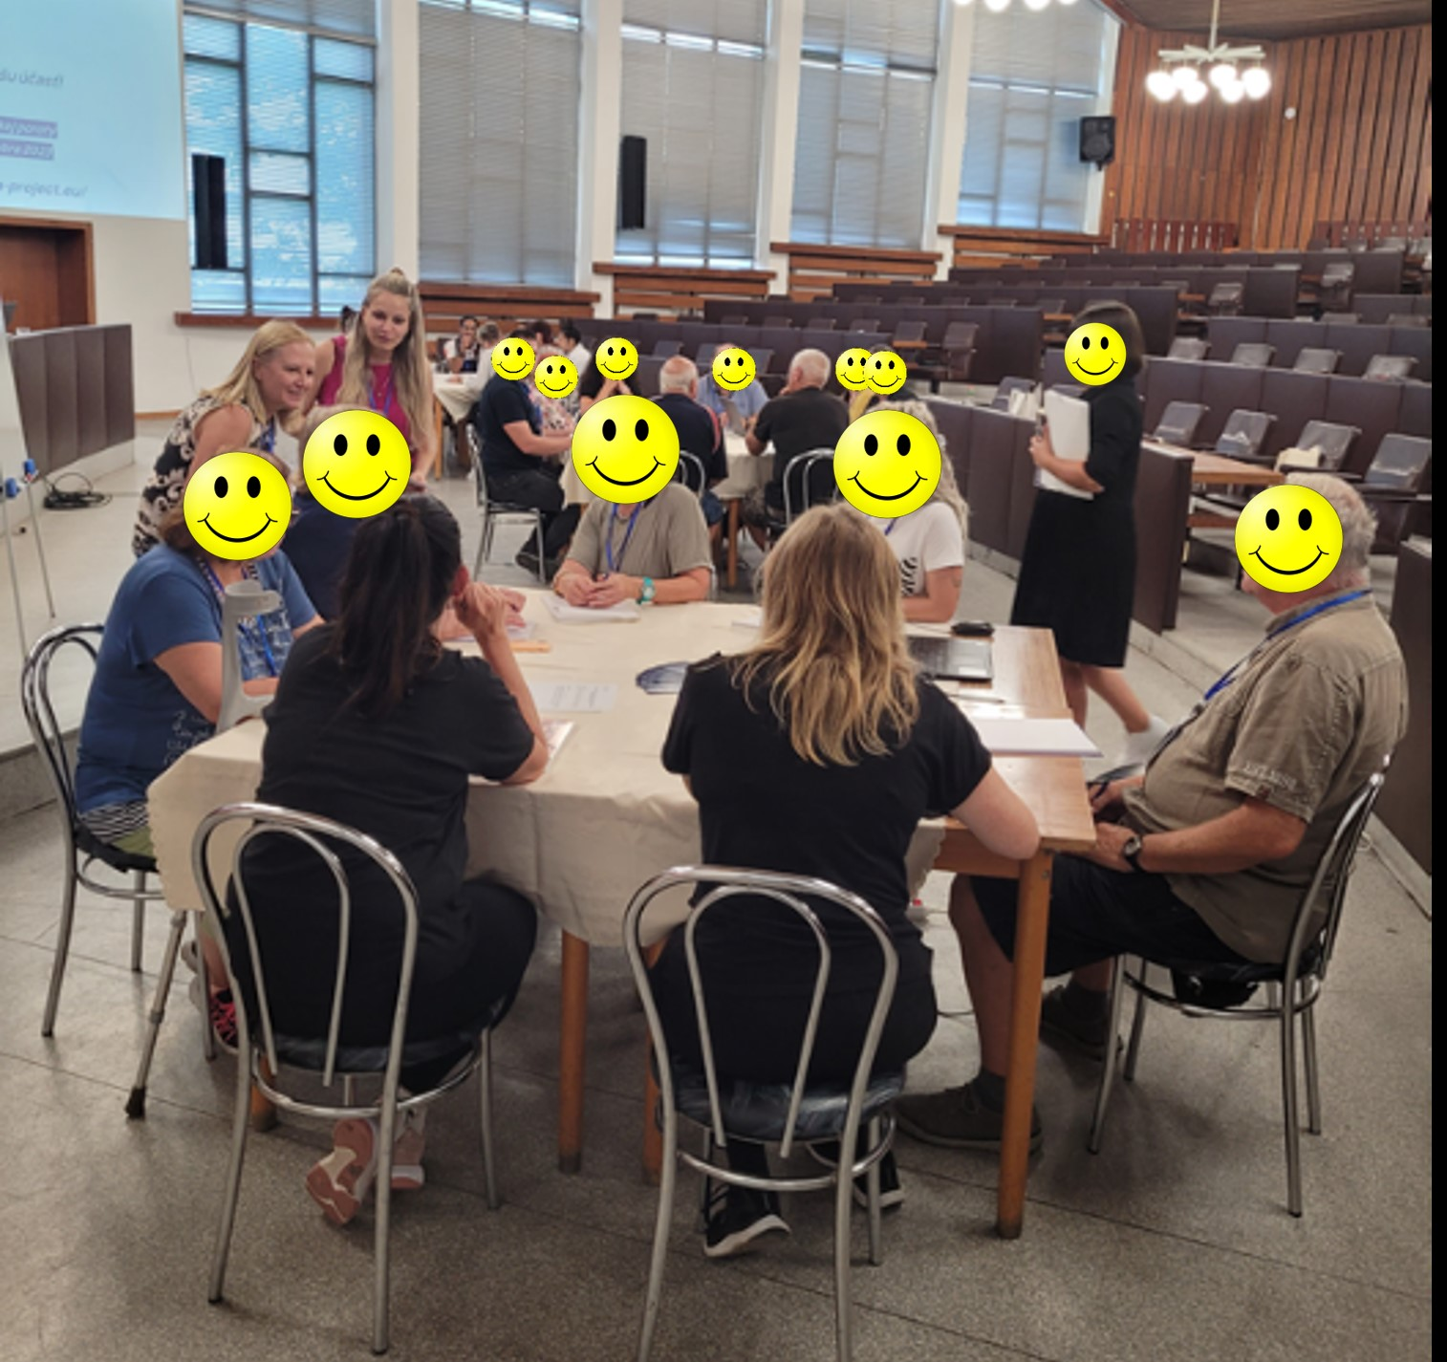
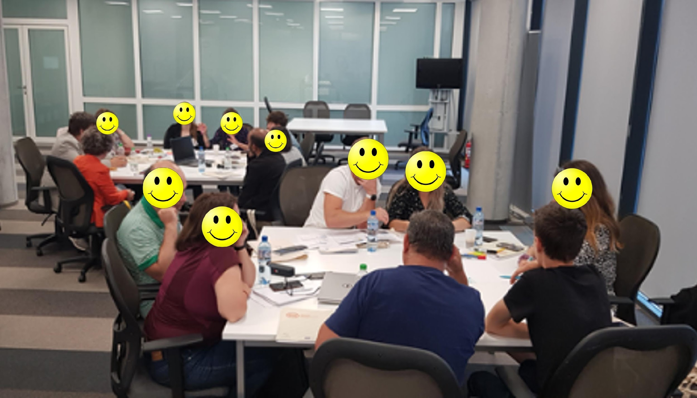
AI Citizen Juries
2 Workshops (July and December 23) in both Pilot Cities
(n ≈ 25+ in each of the 4 Workshops)
Expense Allowance: 80 € per WS
Discussions to identify potential harms of AI in the context of civic participation
Listen to their concerns, risks and challenges
Working out strategies, how AI could facilitate their needs and wishes for civic participation

Slide 83
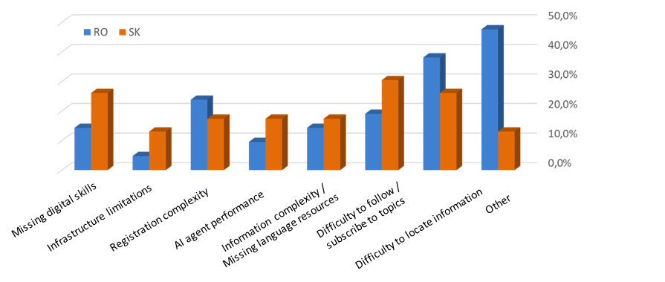
AI Citizen Juries : Main Technology Barriers
Notes:
Missing digital skills, Infrastructure limitations, registration complexity, AI agent performance, information complexity/Missing language resources, difficulty to locate information, difficulty to follow/subscribe to topics, other

Slide 84
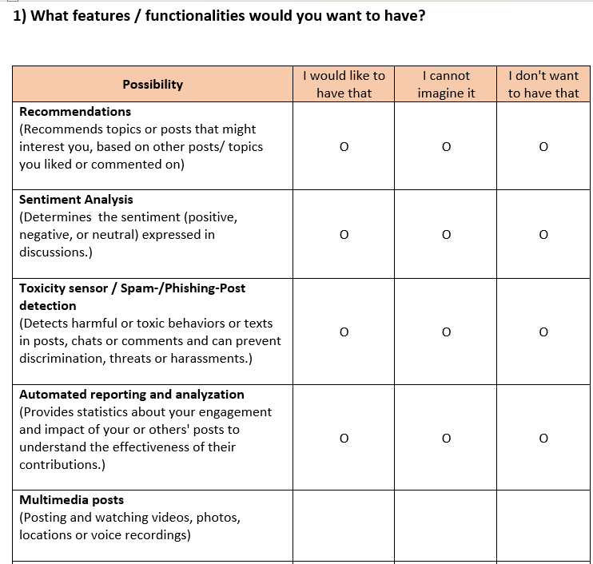
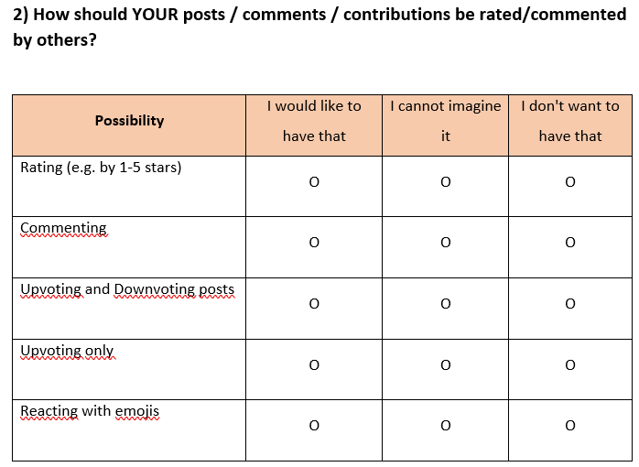
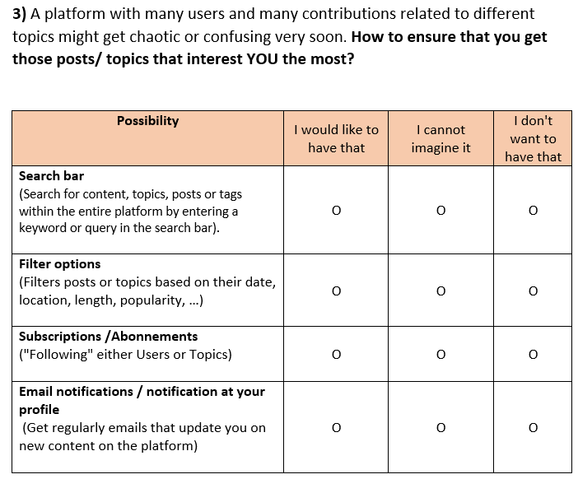
Platform requirements of end users: questionnaire
Open-answer field after every cluster of possibilities

Slide 85
Conclusions
Elements that contributed to the successful inclusion of vulnerable groups
Multipliers (Representatives)
Expense Allowance, refreshments and snacks
Open atmosphere and discussion culture
Honest interest in the AI Citizen Juries voices, comments, ideas & suggestions and feedback
Continuity (2 WSs, to a large extent the same participants)

Slide 86
Thank you!
If you have any further questions that come up in the following days or if you are interested in the ITHACA project, please do not hesitate to contact us:
michael.bedek@uni-graz.at or maria.zangl@uni-graz.at

Slide 87
Agenda
11:00 - 12:30 | Part 1 A theoretical grounding on conducting responsible AI in democratic processes, via a series of short keynotes | AI and Democracy: Risks and Opportunities Prof Keith Hyams, University of Warwick, UK Online Deliberation: Bridging Theory and Practice Prof Anna De Liddo, Open University, UK Trustworthy and Explainable AI in Policy Making: How can we enhance trustworthiness, fairness and explainability of the modern AI by enabling humans to reason about the outcomes of AI-based models. Fabiana Fournier, IBM Research, Israel Aiming for participatory democracy and the inclusion of vulnerable groups: challenges, aspirations and lessons Michael Bedek and Maria Zangl, University of Graz Panel Discussion

Slide 88
Panel Discussion
Mentimeter survey
10 minutes
Reflect and fill before the panel discussion
Join at menti.com | use code 7976 2214

Slide 89
Panel Discussion
Mentimeter survey
Reflect and fill before the panel discussion
Join at menti.com | use code 7976 2214
ai-big-data-and-democracy-task-force@googlegroups.com

Slide 90
Intermission
See you back at 13:30
ai-big-data-and-democracy-task-force@googlegroups.com

